Slide 1
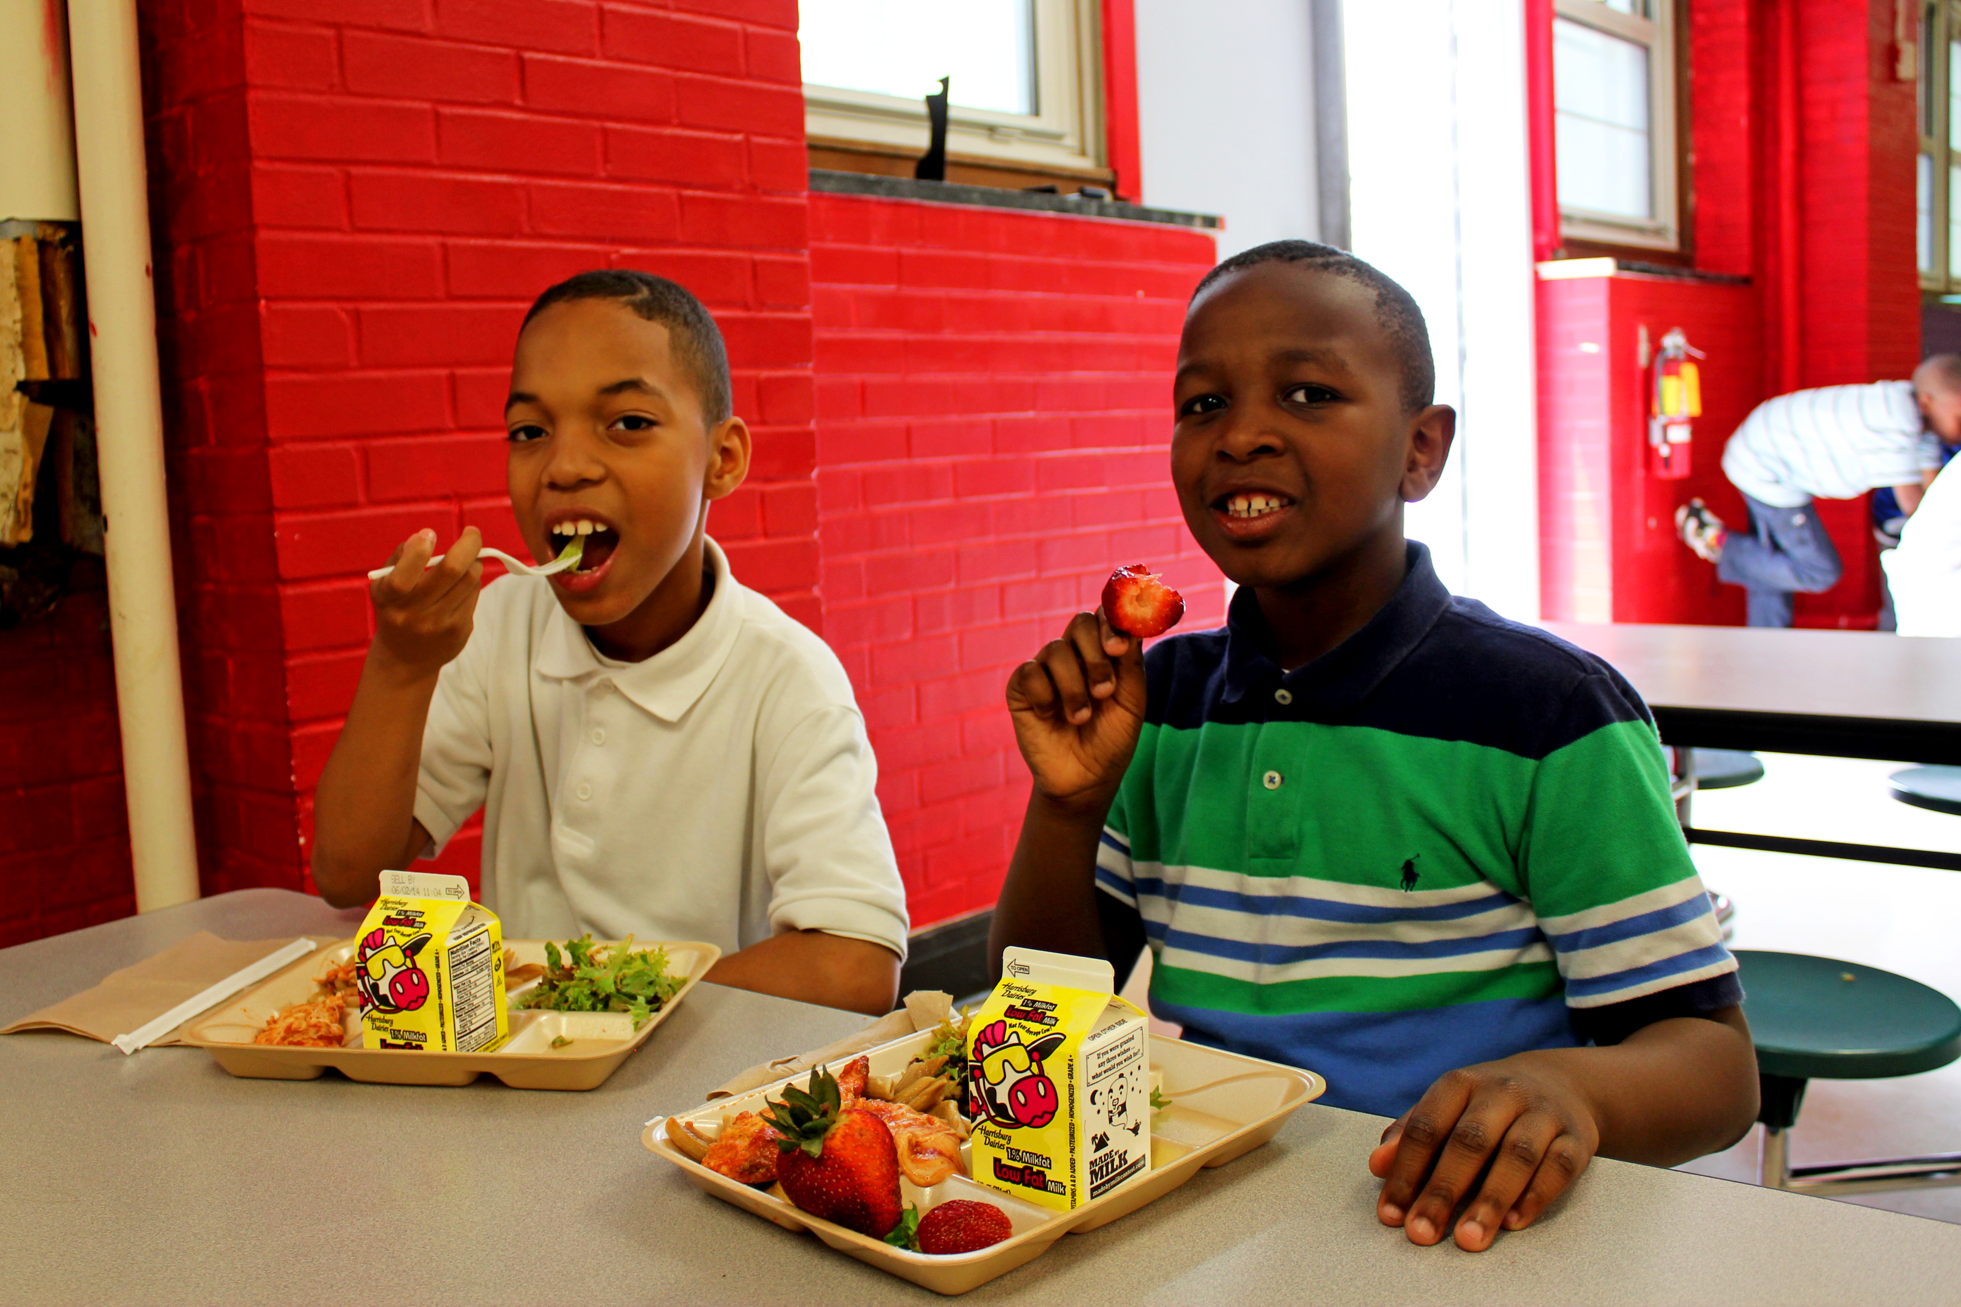
Notes:
Nov 17 - CN - DC - Strawberries 2
USDAgov
https://www.flickr.com/photos/usdagov/15844937015/sizes/o/

Slide 2
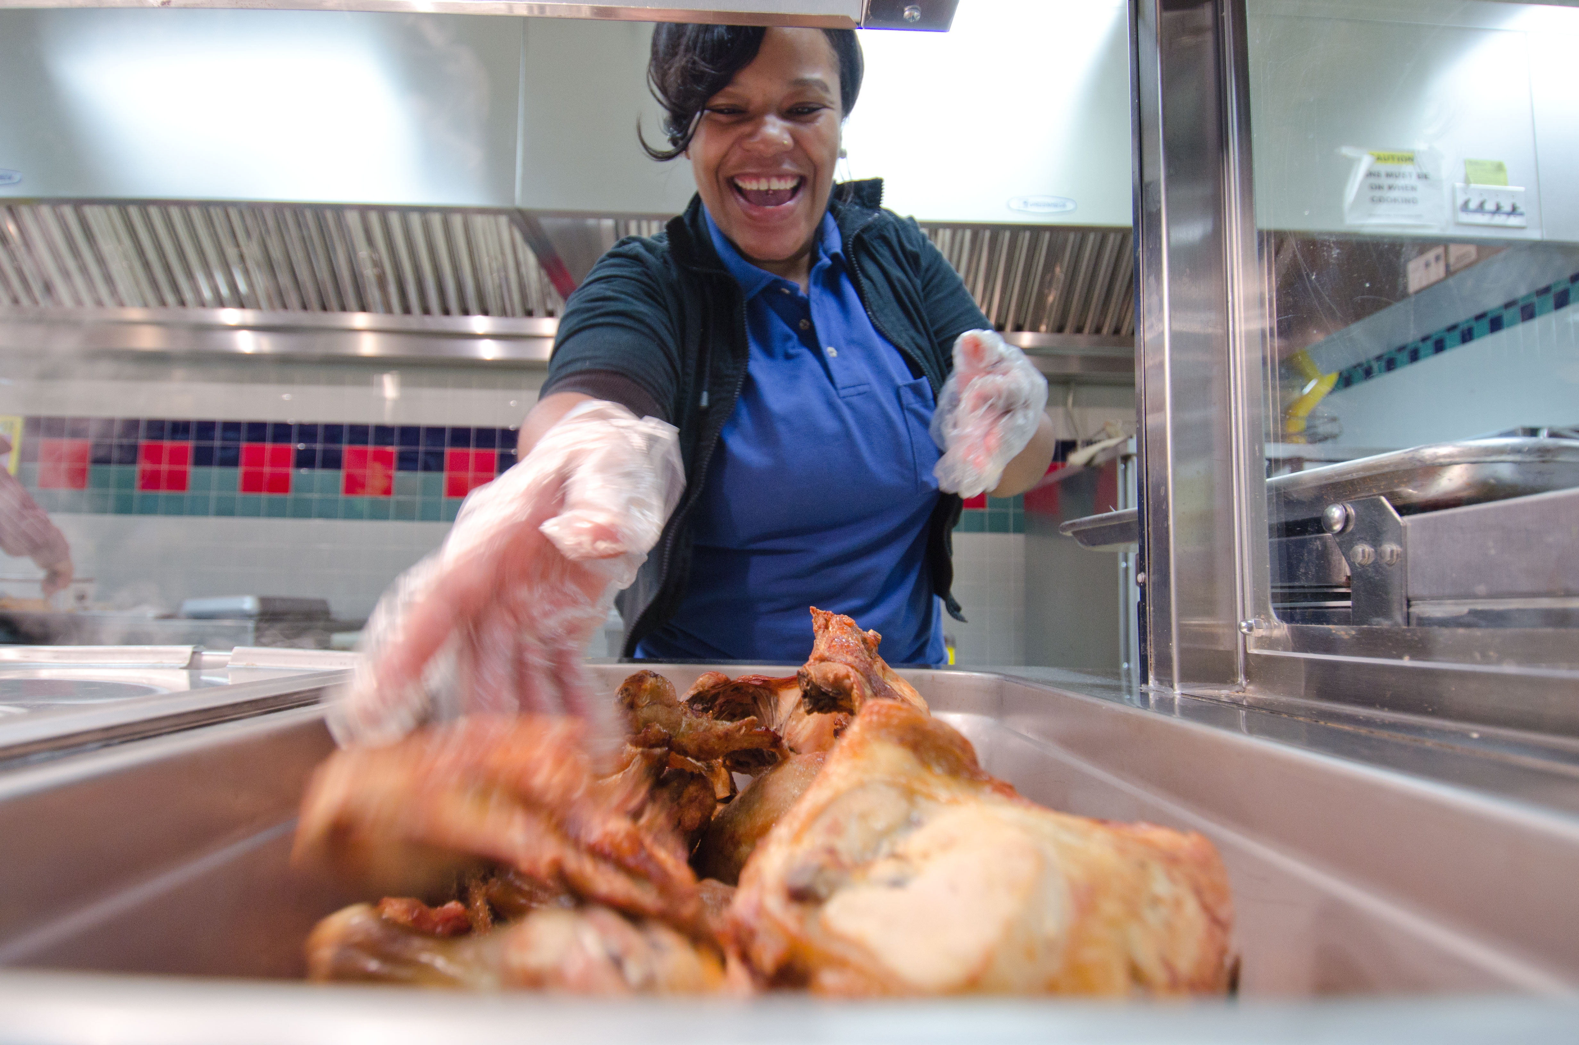
Notes:
20111012-FNCS-LSC-0260 by USDepartment of Agriculture
https://www.flickr.com/photos/usdagov/6239460604/sizes/o/
Nov 17 - CN - DC - Strawberries 2 by USDepartment of Agriculture
https://www.flickr.com/photos/usdagov/15844937015/sizes/o/

Slide 3
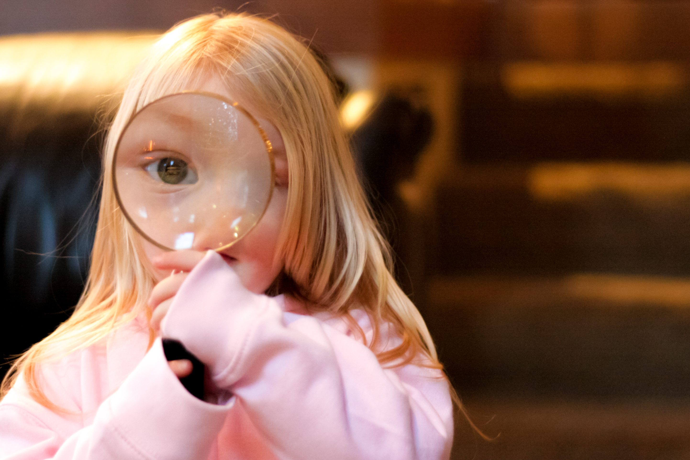

Slide 4
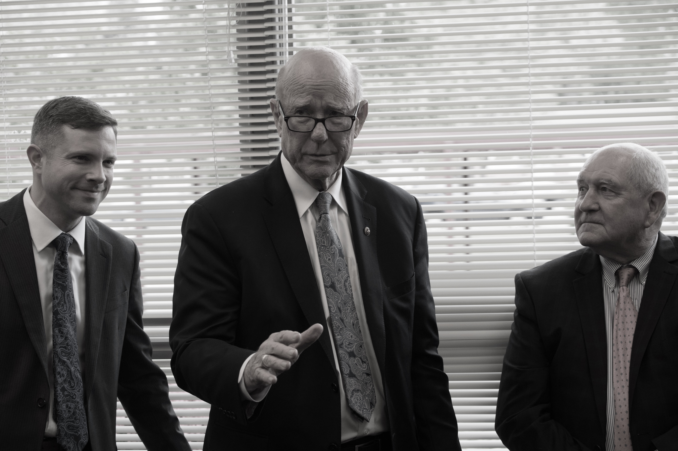

Slide 5
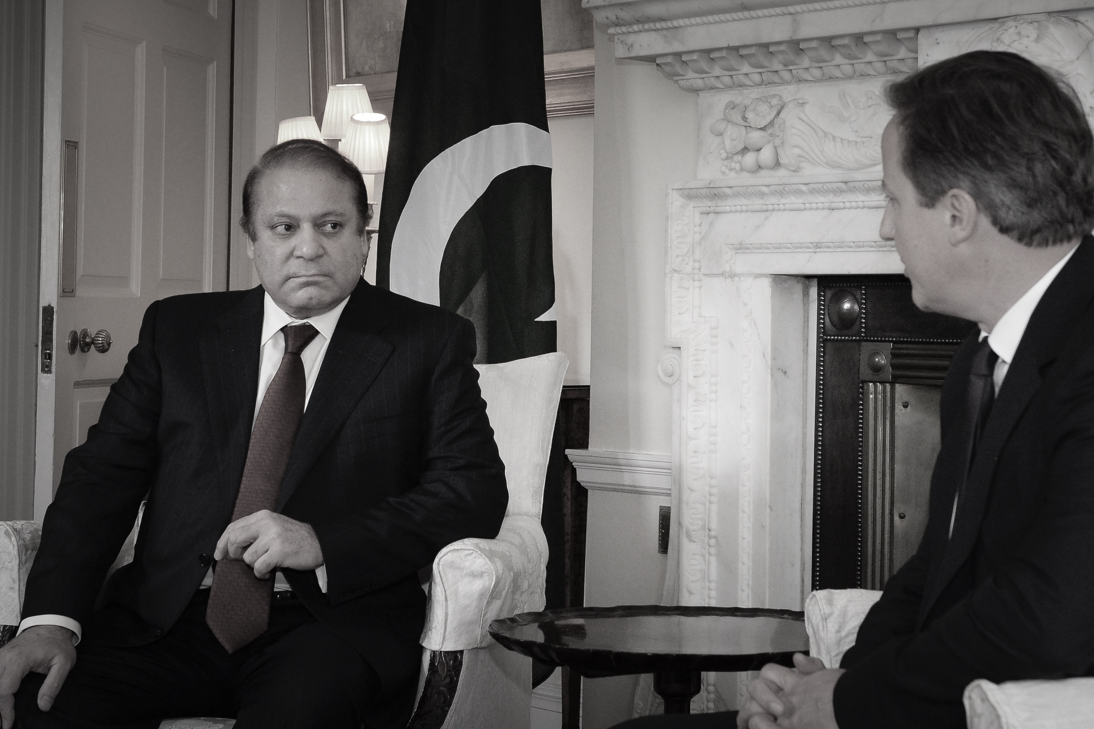

Slide 6
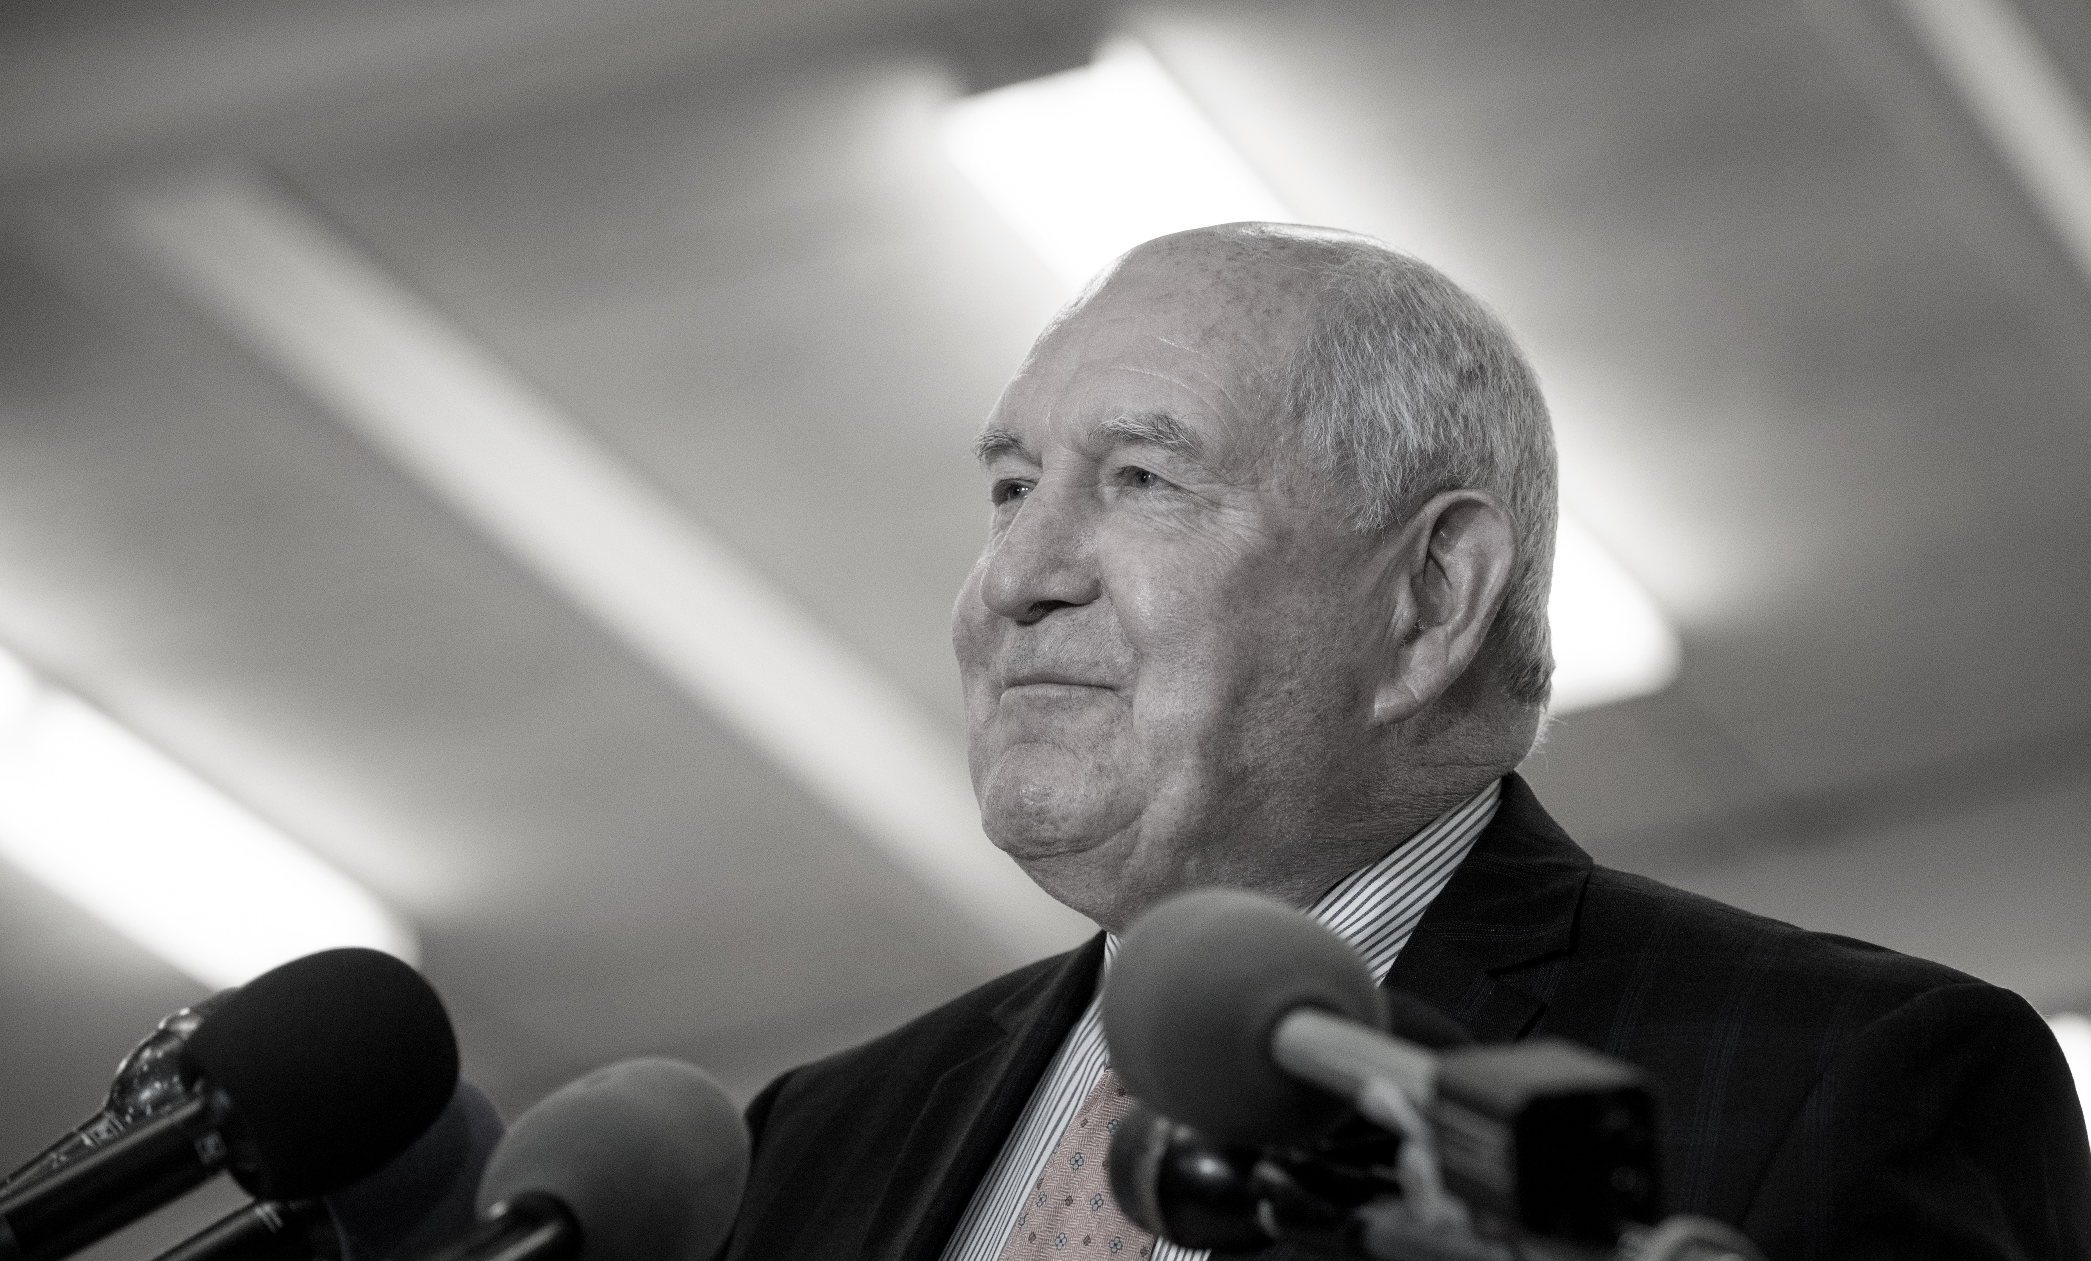
Notes:
Sunny Perdue
USDAgov
Original

Slide 7
PDF The Robust Way

Slide 8
Overview
PDF is Data
Complexity
Workflow
Libraries
Criteria
Tika
PDFBox
PDFTabExtract
Other
Examples
Panama Papers
DropBox Firefly

Slide 9
PDF is data
All data is an input
Humans, The printed page
Assistive Technology

Slide 10
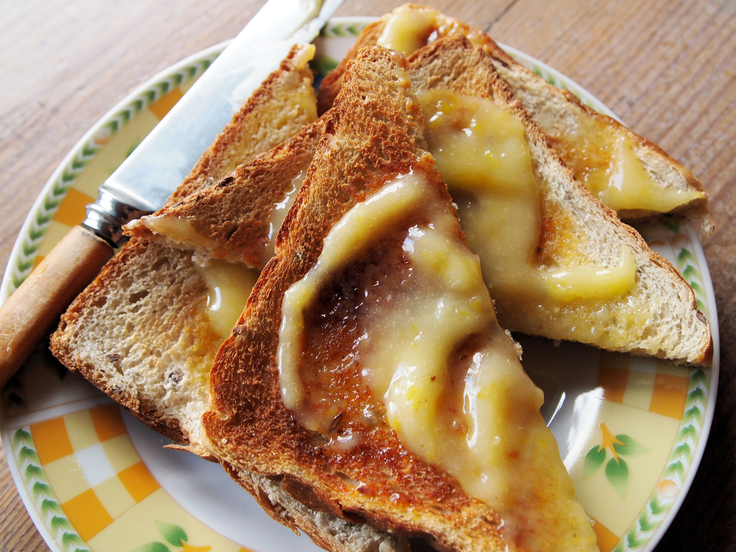
Notes:
https://www.flickr.com/photos/frenchtart/
https://www.flickr.com/photos/frenchtart/5483255768/sizes/l

Slide 11
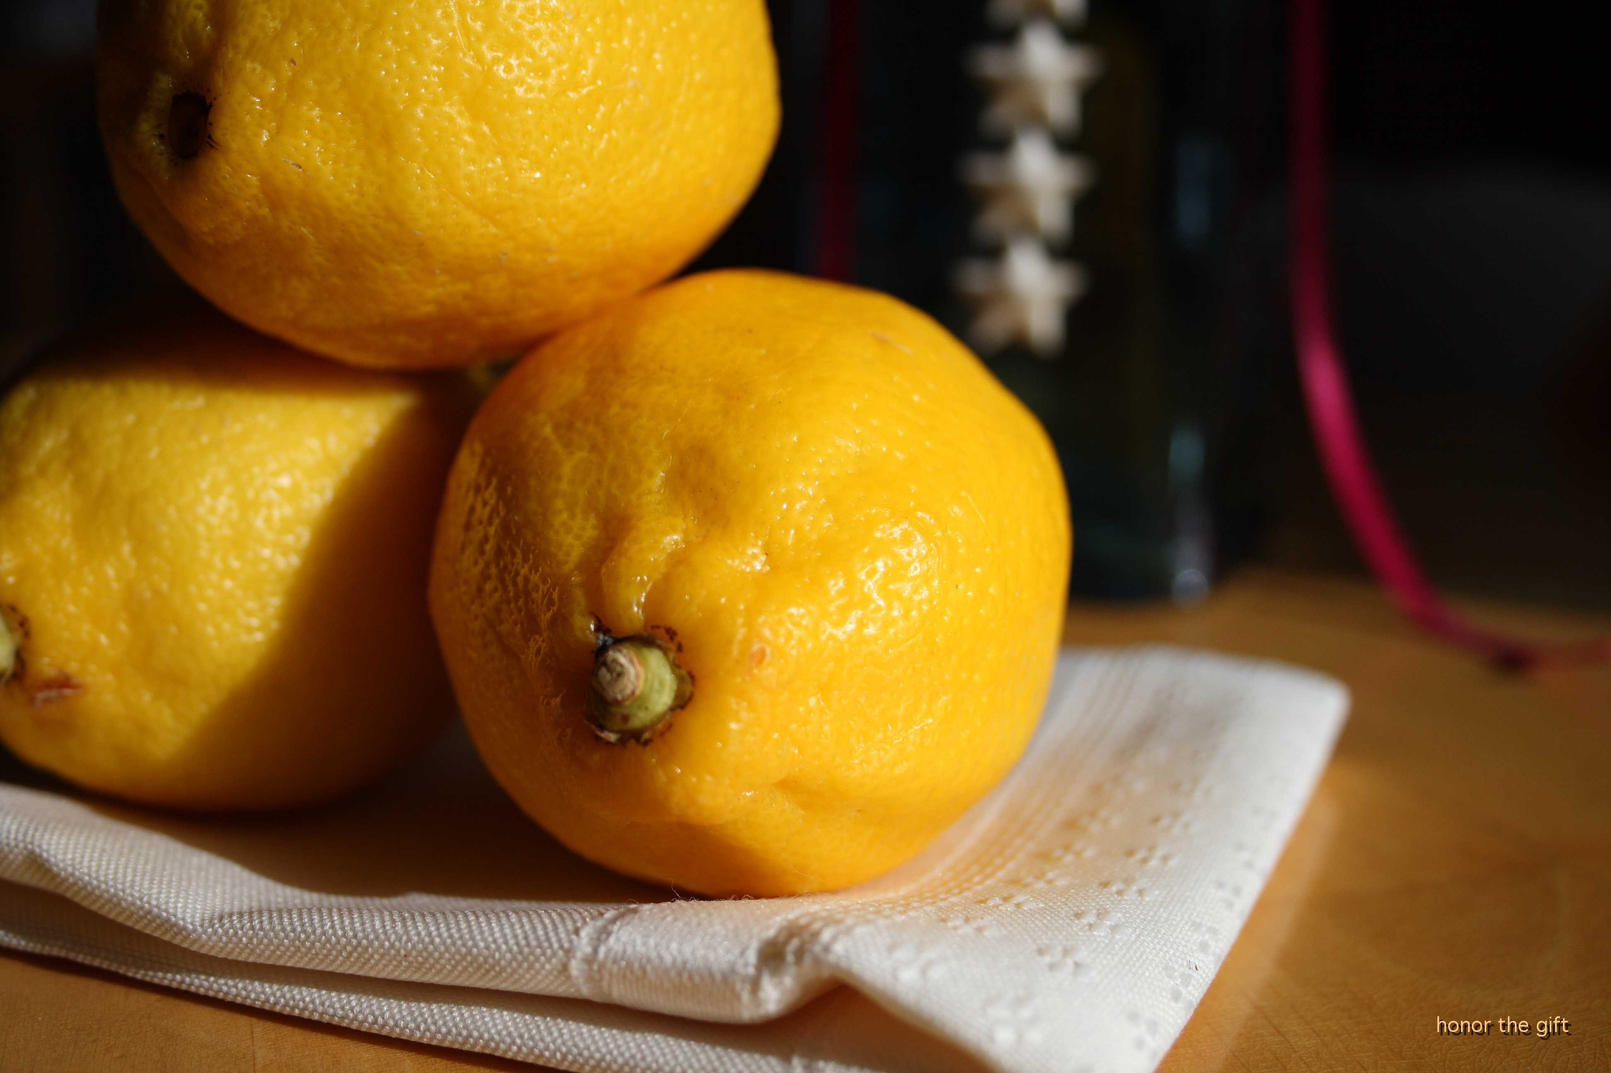
Notes:
Lemon
honor the gift
https://www.flickr.com/photos/honorthegift/5080575540/sizes/o/

Slide 12
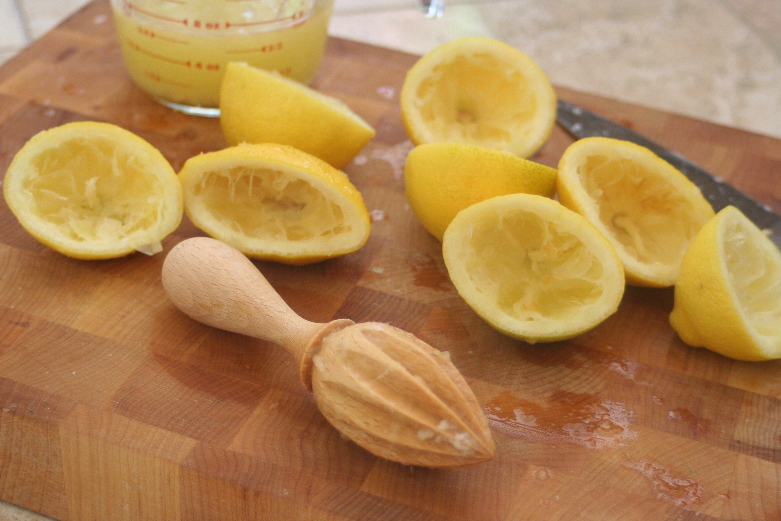

Slide 13
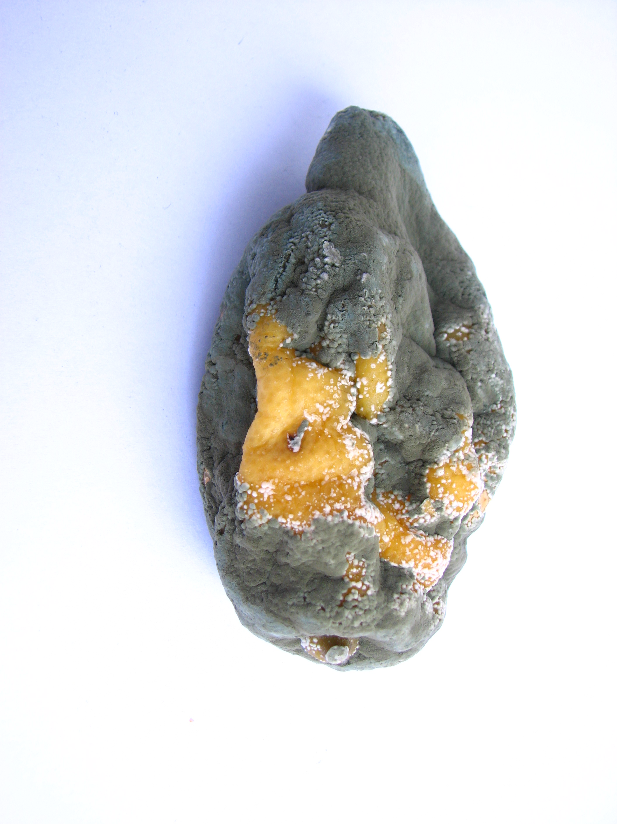
Notes:
Manuel Barroso Parejo
https://www.flickr.com/photos/lute3d/614142045/sizes/o/

Slide 14
Complexity
Low
Just Plain Text
It should still be readable without modification
This may still need editing
Nice for making text searchable
Medium
Images and Text
Grids or Tabular
Sections are in vertical Blocks/Formatting affects meaning little
High
Scanned Text
Labeled data needs to be paired with values

Slide 15
Workflow
Human
Qualitative
Traditional journalist, manager with department reports
Batches, no updates
Printed copies
Machine
Quantitative
Data pipeline for a data product
Large initial input, Updates, Streams
No printing

Slide 16
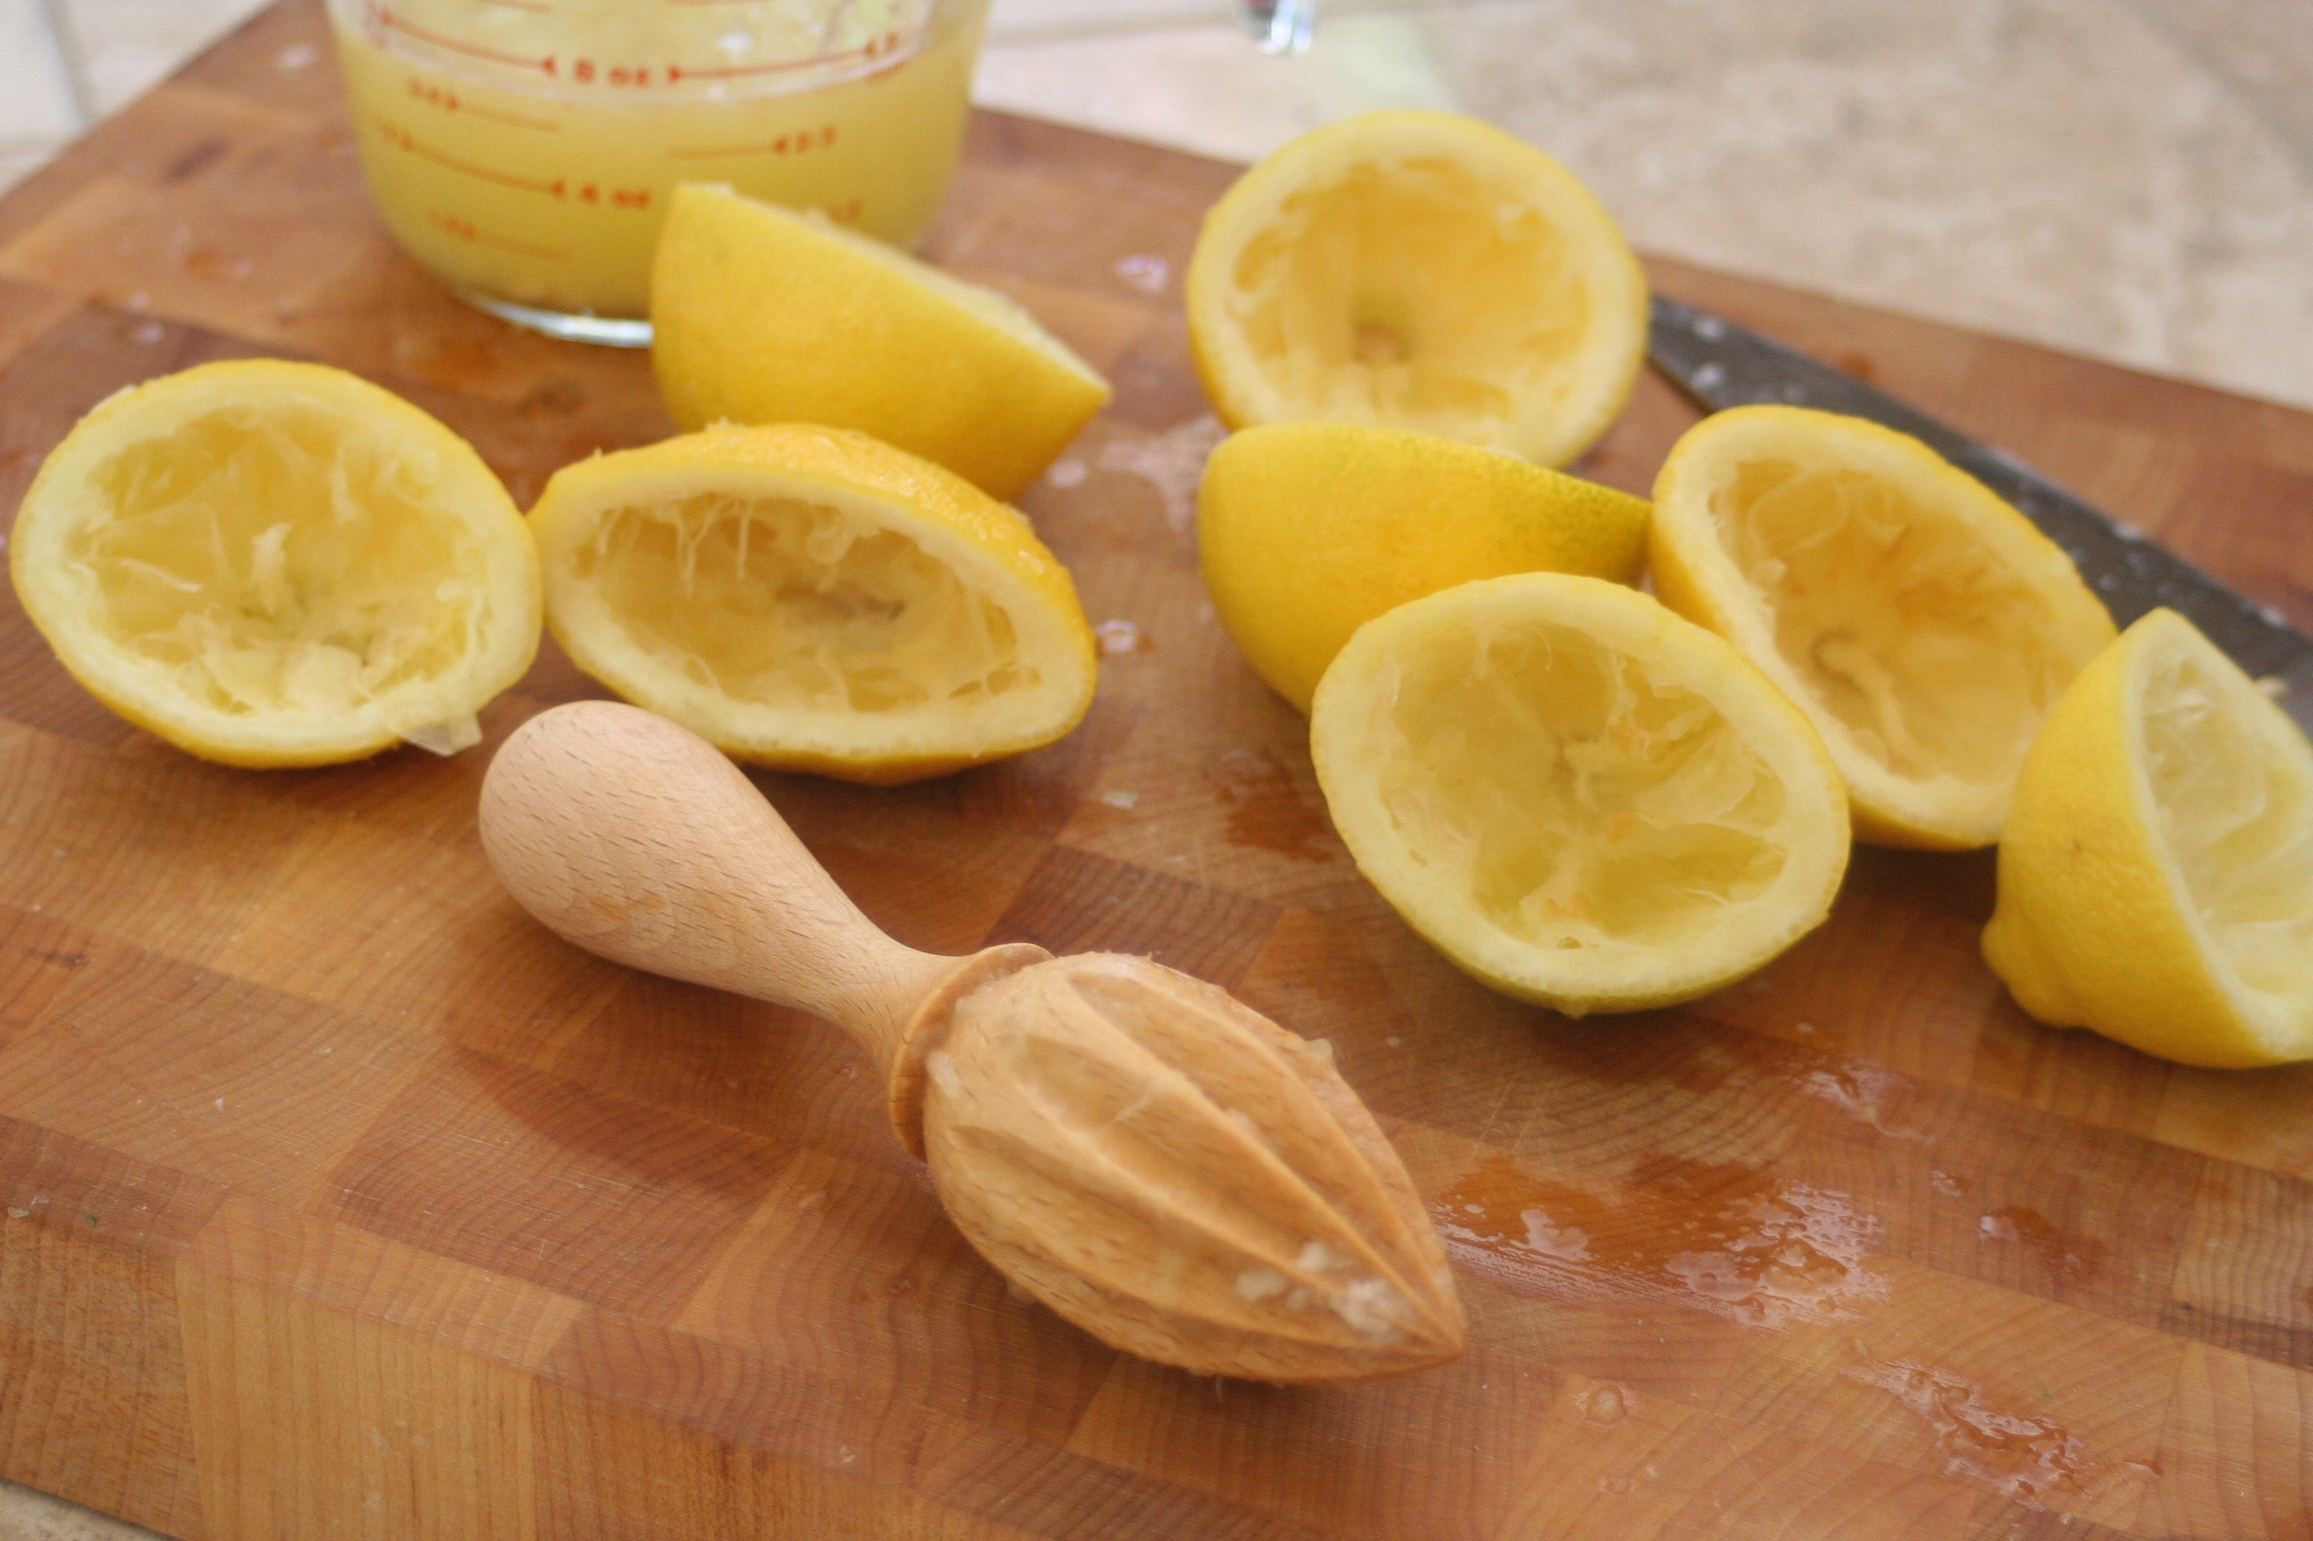
TIKA

Slide 18
Apache Tika
Evaluation - Great
Complexity - Simple
Human or Machine - Either

Slide 19
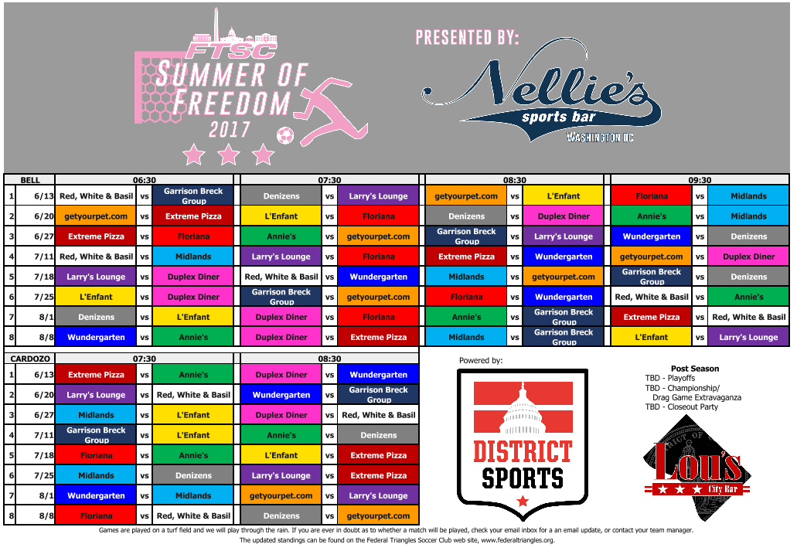
Notes:
A schedule.
Visually appealing
Orderly, yet
Humans fill in the semantic inconsistencies
Document created in Excel

Slide 20
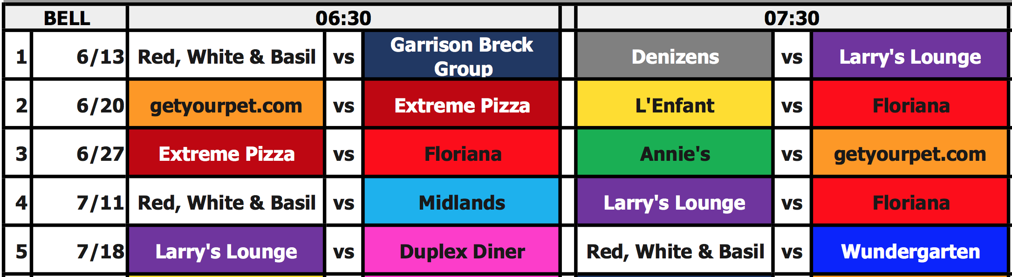

Slide 21
Illustrative Text!
1 6/13 Red, White & Basil vs Garrison Breck Group Denizens vs Larry's Lounge getyourpet.com vs L'Enfant Floriana vs Midlands
2 6/20 getyourpet.com vs Extreme Pizza L'Enfant vs Floriana Denizens vs Duplex Diner Annie's vs Midlands
3 6/27 Extreme Pizza vs Floriana Annie's vs getyourpet.com Garrison Breck Group vs Larry's Lounge Wundergarten vs Denizens
4 7/11 Red, White & Basil vs Midlands Larry's Lounge vs Floriana Extreme Pizza vs Wundergarten getyourpet.com vs Duplex Diner
5 7/18 Larry's Lounge vs Duplex Diner Red, White & Basil vs Wundergarten Midlands vs getyourpet.com Garrison Breck Group vs Denizens

Slide 22
Show Some Code
Import Tika
Get a Parser
Grab the metadata
Grab the Text

Slide 23
Simple Text Extraction
What happened to the delimiters?
What happened to the header values?
Can this text be parsed so that context is retained?
The top half and the bottom half have different time headers?

Slide 24
PDFBox

Slide 25
Apache PDFBox
Evaluation - Great
Complexity – Moderate Code, Set-up high
Workflow - Human or Machine - Either

Slide 26
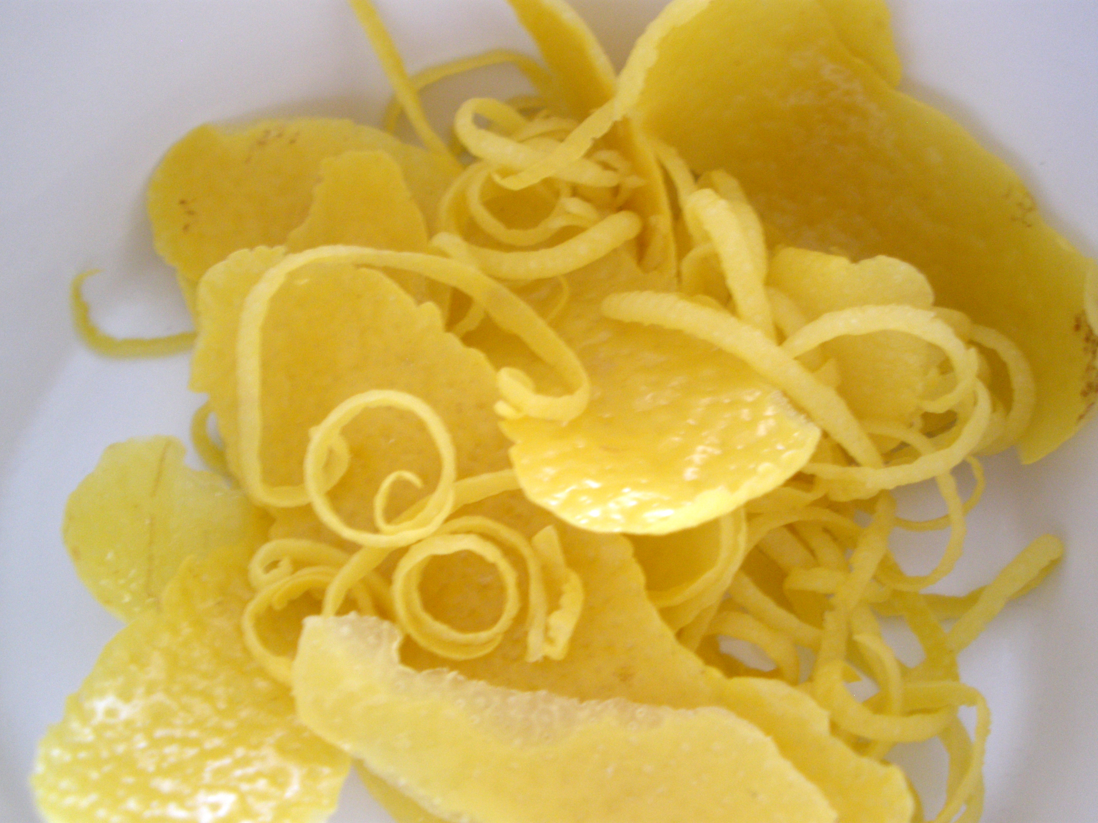
Notes:
bigal_60714
https://www.flickr.com/photos/alejandraowens/5365303225/sizes/o/

Slide 27
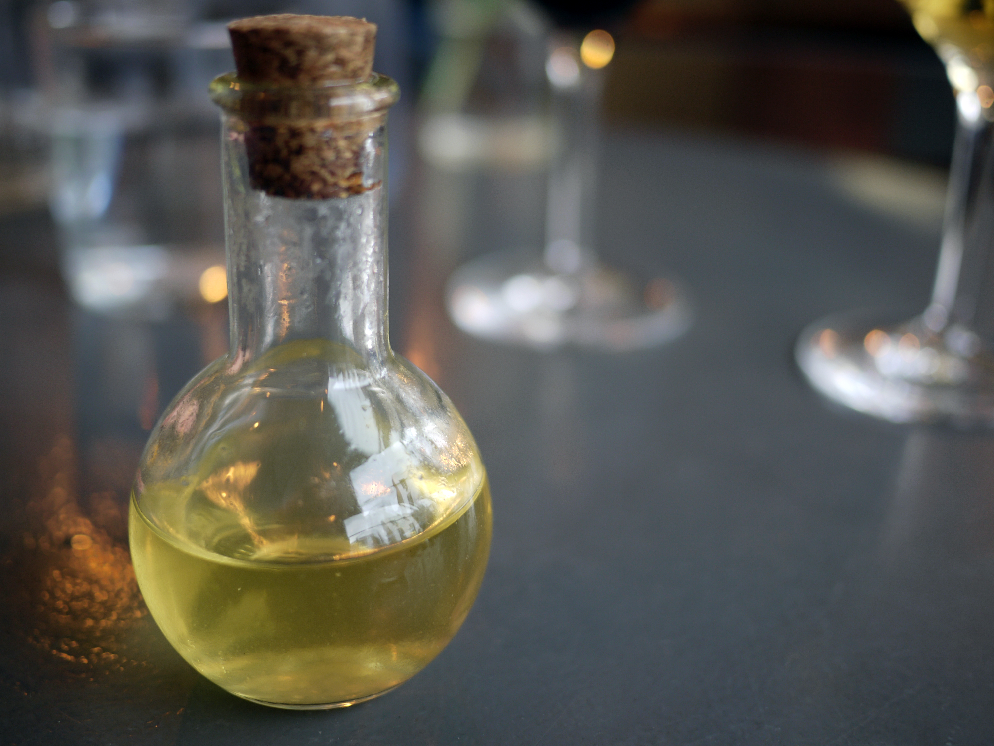
Notes:
Pidgin lemoncello
https://c1.staticflickr.com/5/4176/33805510234_31b932962b_o_d.jpg
Chris Pople
https://www.flickr.com/photos/60173925@N06/

Slide 28
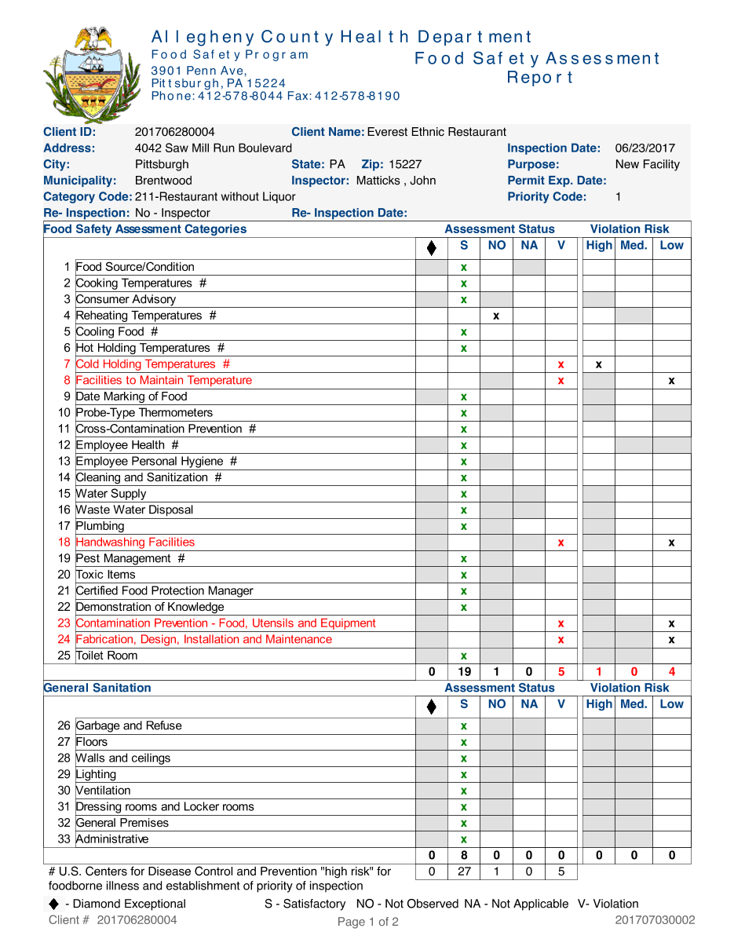
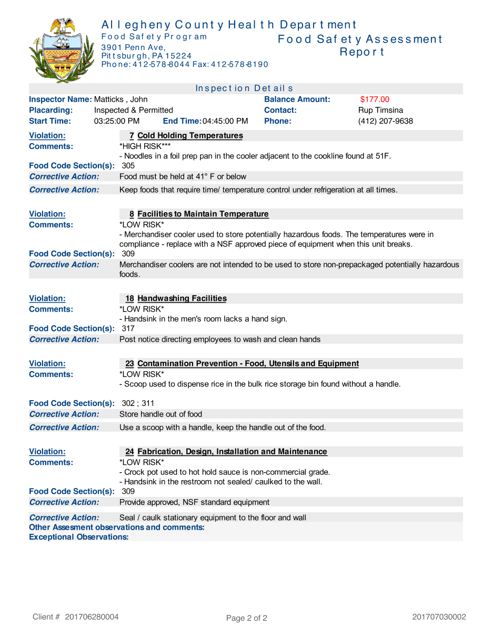
PDF is data
Notes:
201707030002, http://appsrv.achd.net/reports/rwservlet?food_rep_insp&P_ENCOUNTER=201707030002

Slide 29
PDF is data
Notes:
201707030002, http://appsrv.achd.net/reports/rwservlet?food_rep_insp&P_ENCOUNTER=201707030002

Slide 30
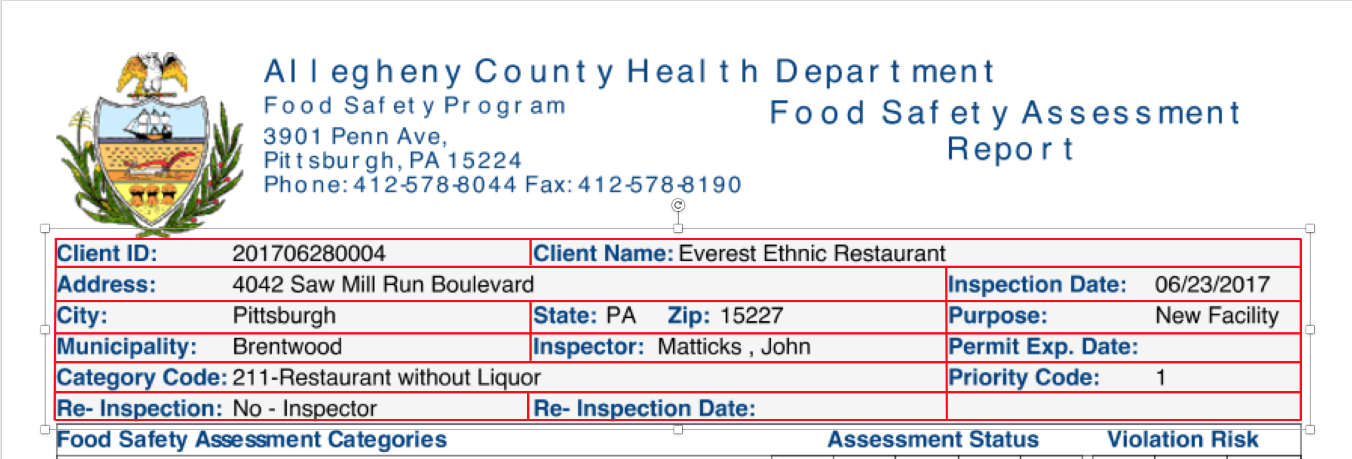

Slide 31
Show Some Code
PDF File
Identify A Page
Text Stripper
Define Regions
Create Regions
Name Regions
Review and revise

Slide 32
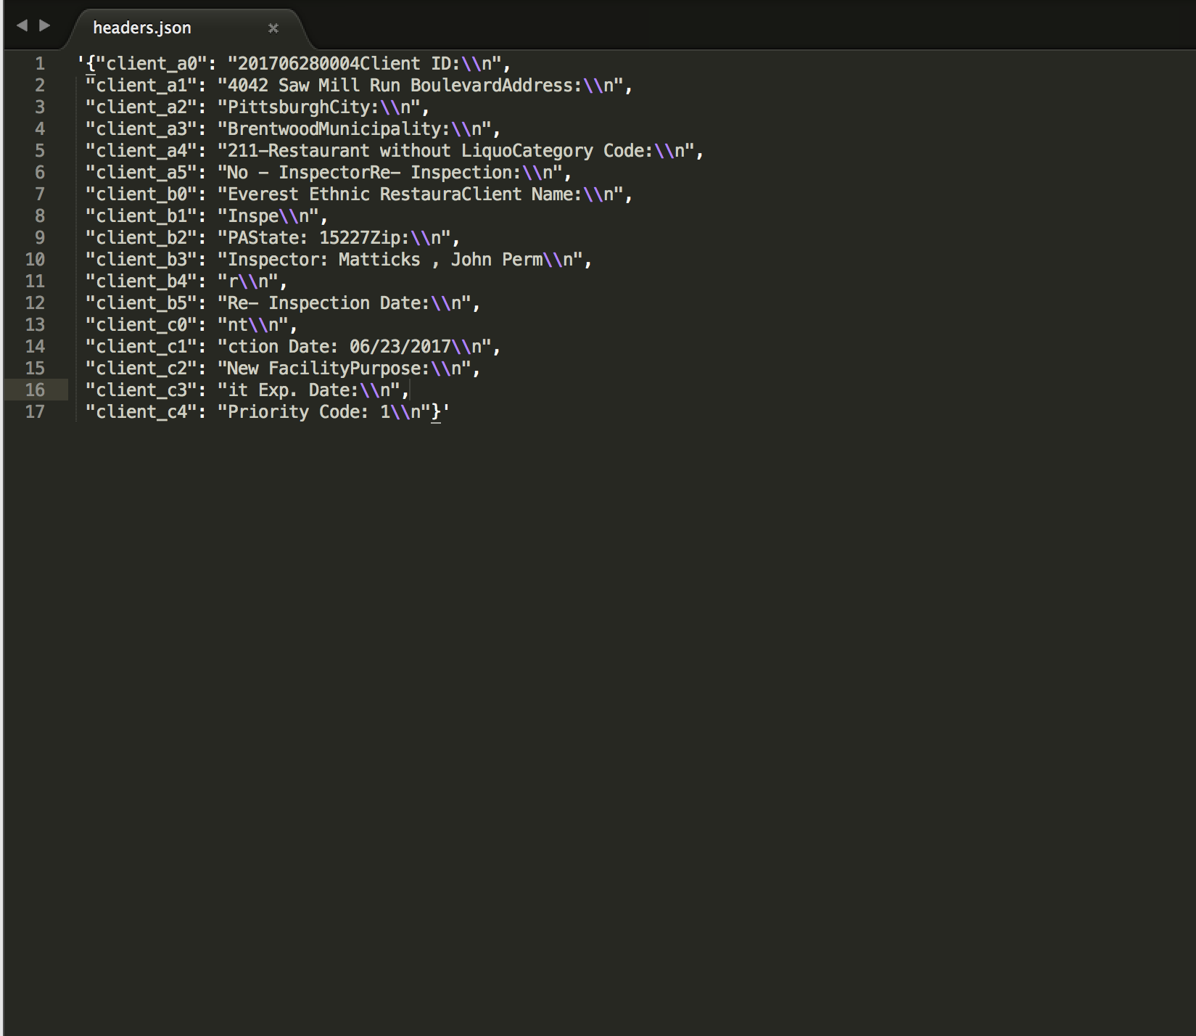

Slide 33
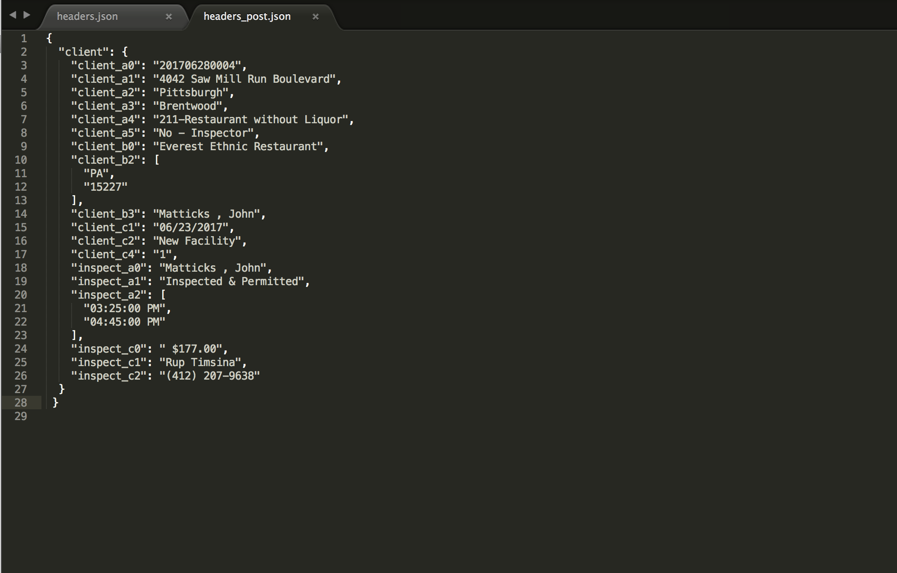

Slide 34
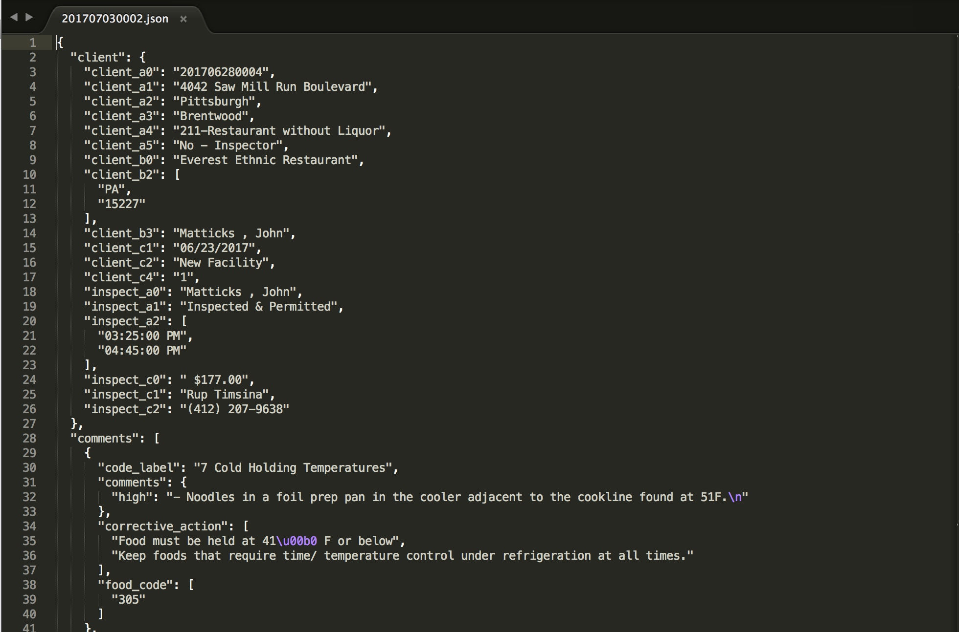
Notes:
http://remix.epiccry.com/json/201707030002

Slide 35
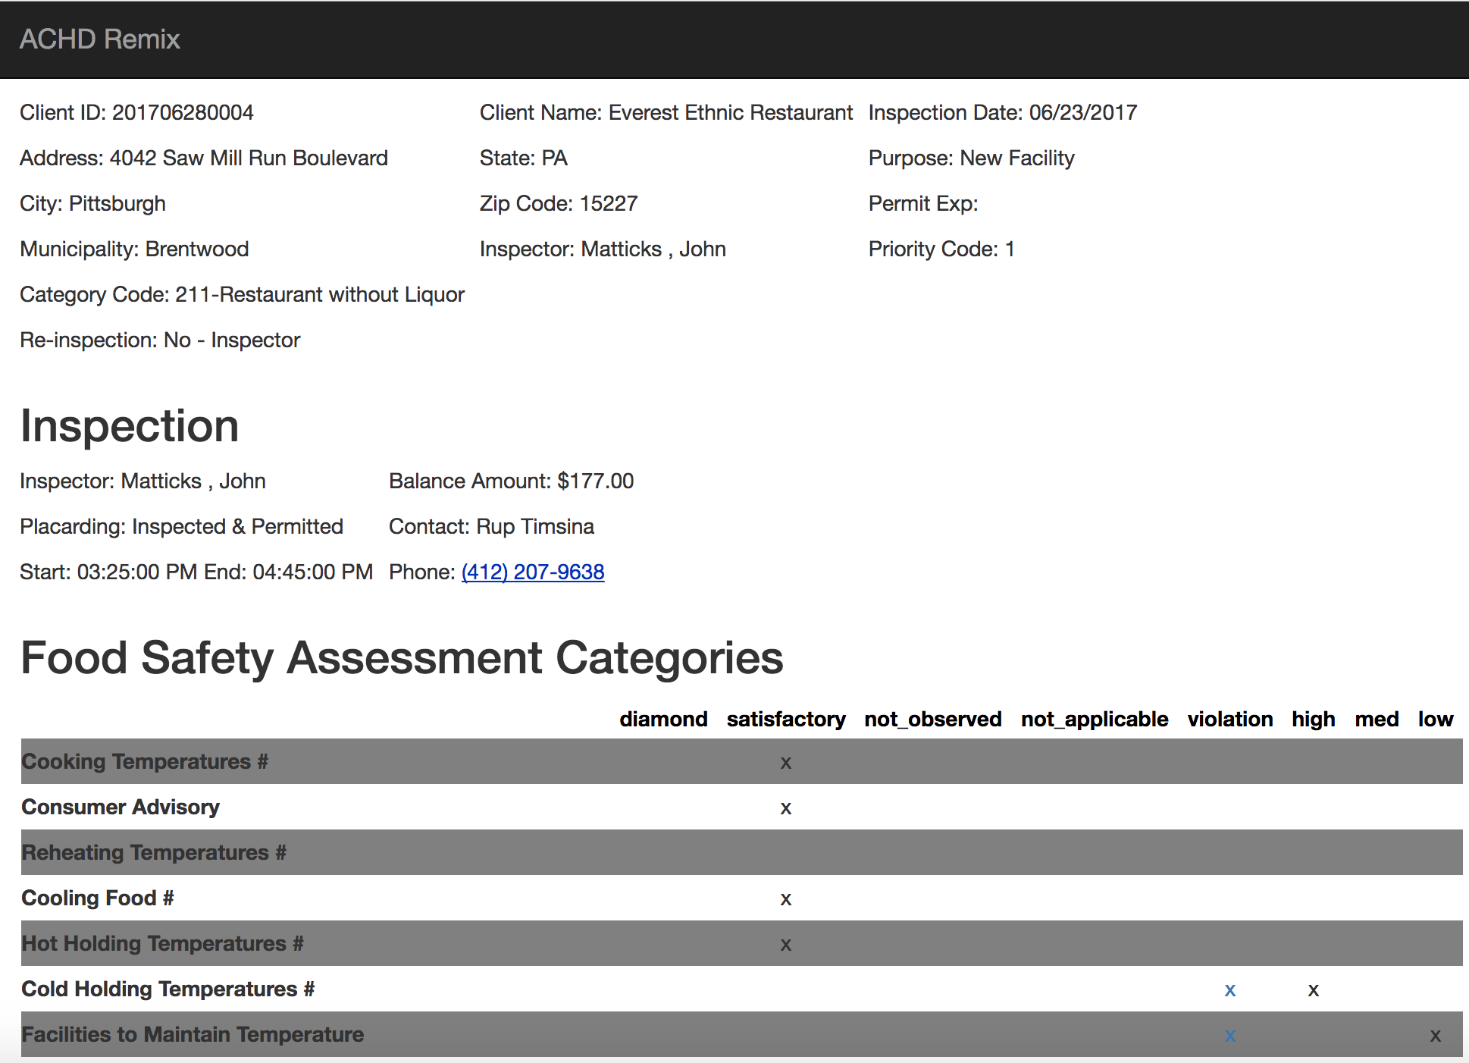
Notes:
http://remix.epiccry.com/inspection/201707030002

Slide 36
PDFTabExtract

Slide 37
PDFTabExtract
Evaluation – So, So – your use case must match the tool tightly
Complexity - Complex
Human or Machine - Either

Slide 38
Very Specific Use Criteria
Must have a sandwich PDF
Must have an image in the upper left-hand corner
Must have gridlines so that OpenCV can recognize the orientation
Must use poppler tools to get XML with coordinates
If not a “ Sandwich PDF ” , Use Tesseract as OCR Tool
Tesseract is powerful, but more complicated than setting up Jython

Slide 39
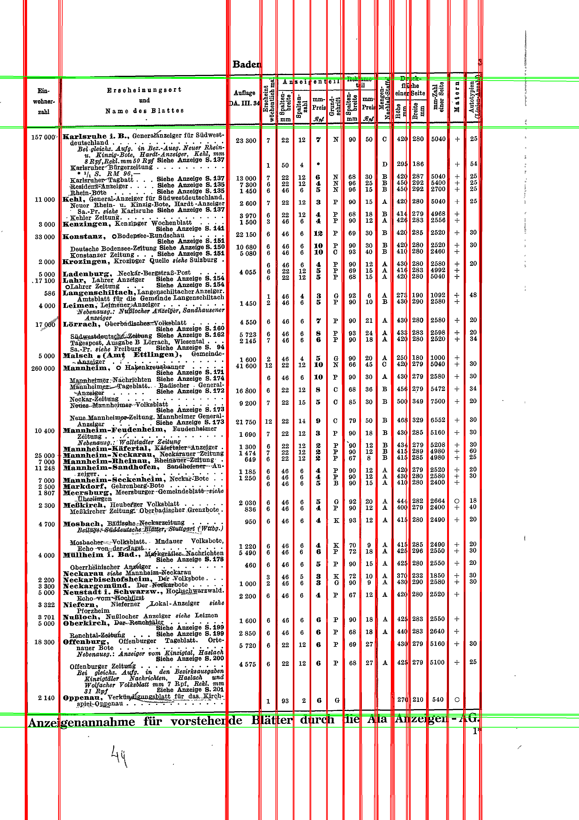
Tutorial Example Document

Slide 40
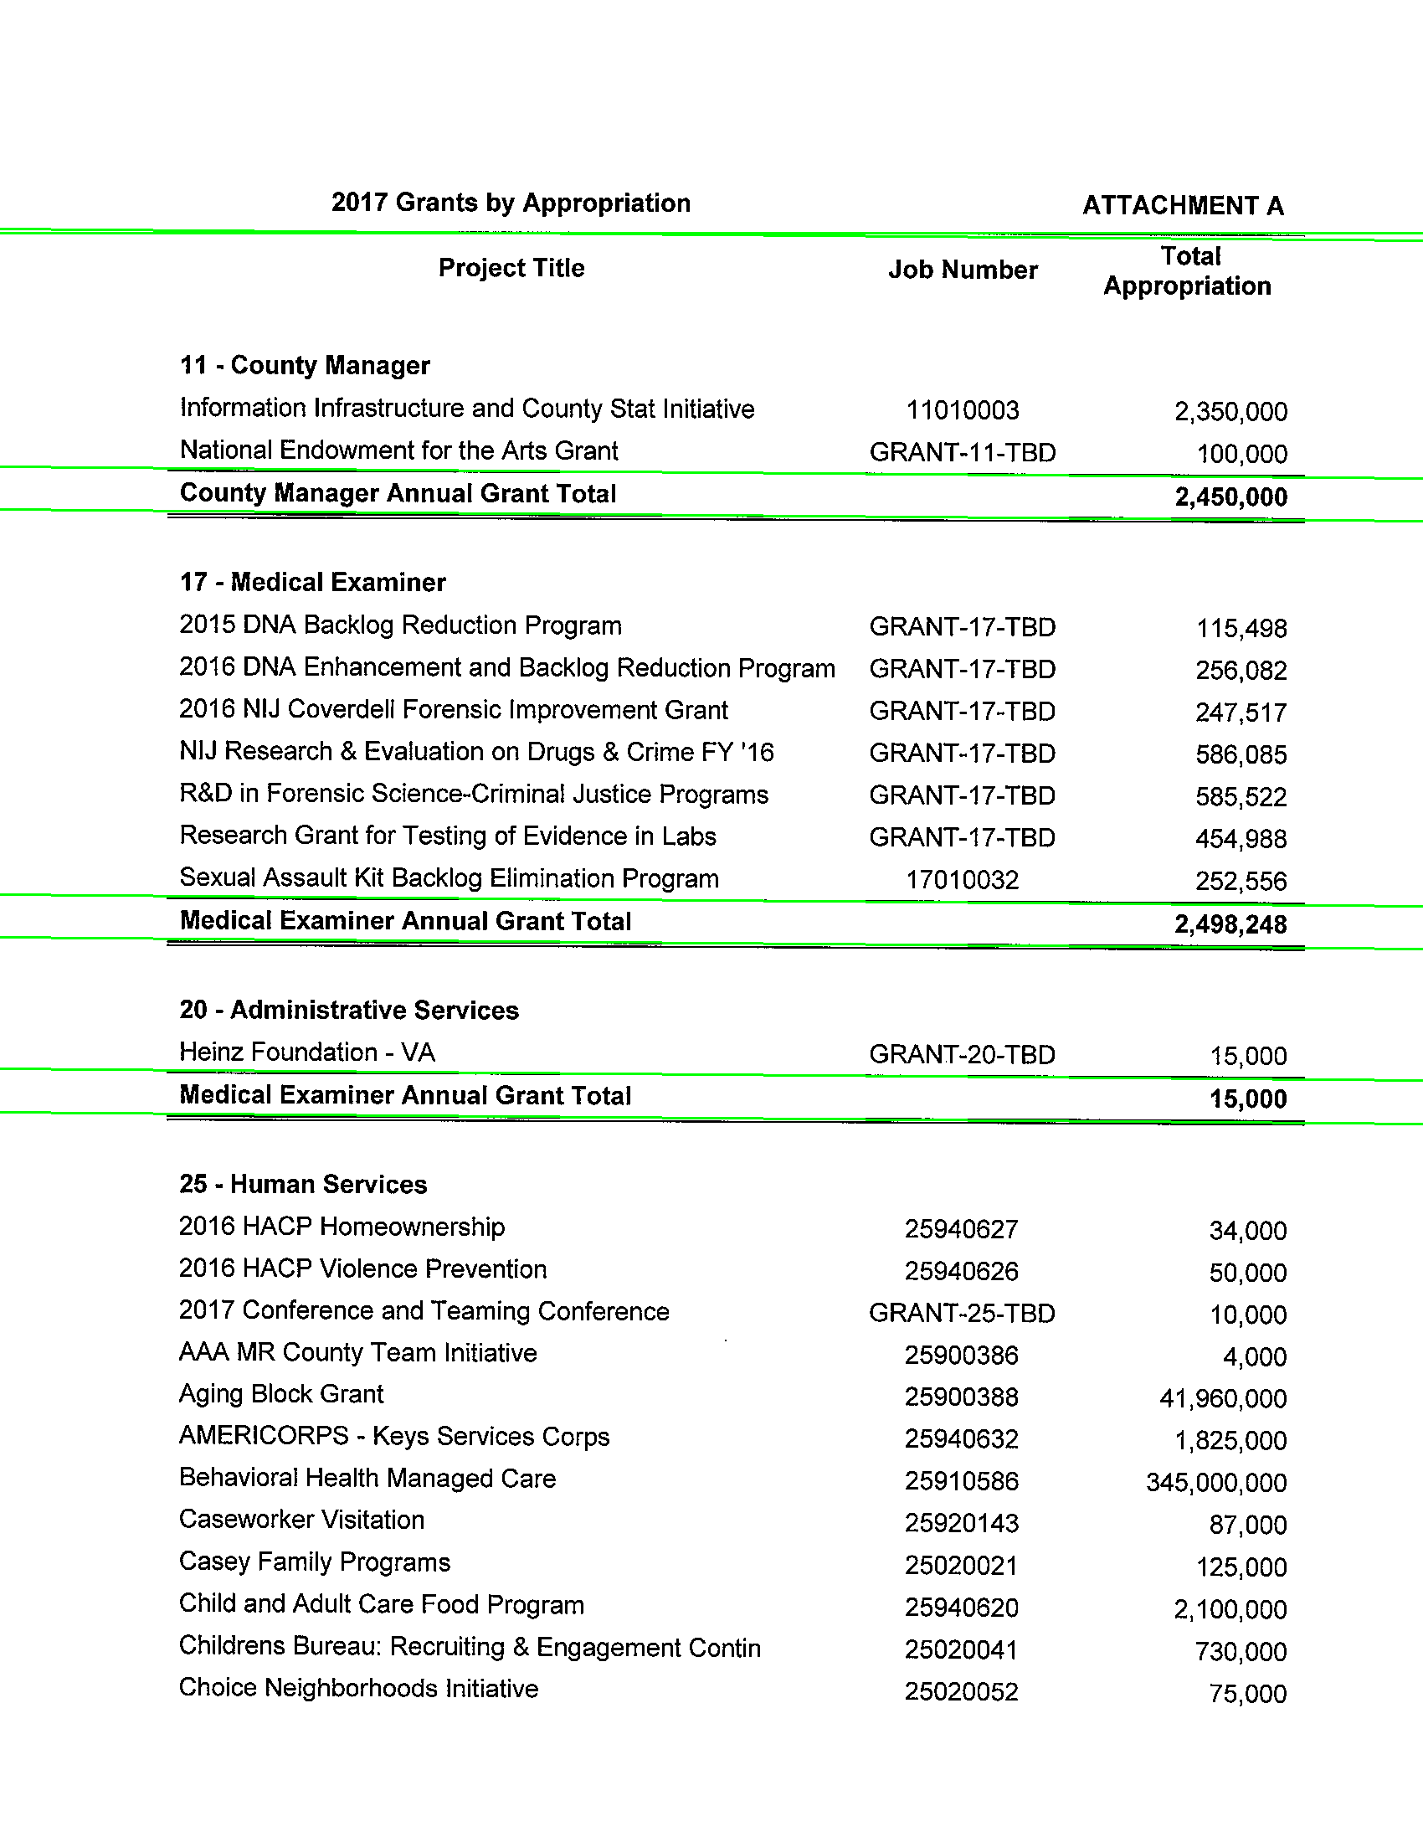
My Example Document
Notes:
This Slide Contains Sensitive Material

Slide 41
Complexity
Low
Just Plain Text
It should still be readable without modification
This may still need editing
Nice for making text searchable
Medium
Images and Text
Grids or Tabular
Sections are in vertical Blocks/Formatting affects meaning little
High
Scanned Text
Labeled data needs to be paired with values

Slide 42
Workflow
Human
Qualitative
Traditional journalist, manager with department reports
Batches, no updates
Printed copies
Machine
Quantitative
Data pipeline for a data product
Large initial input, Updates, Streams
No printing

Slide 43
Criteria

Slide 44
Libraries
Tika
PDFBox
PDFTabExtract
Others
PyPDF2
Tabula

Slide 45
Apache Tika
Evaluation - Great
Complexity - Simple
Human or Machine - Either

Slide 46
Example PDF

Slide 47
Example Output

Slide 48
Example Output

Slide 49
Examples
Panama Papers
Dropbox Firefly

Slide 50
PANAMA PAPERS
Notes:
Lemon
honor the gift
https://www.flickr.com/photos/honorthegift/5080575540/sizes/o/

Slide 51
Notes:
PM of Pakistan visits Downing Street
https://www.flickr.com/photos/number10gov/
https://www.flickr.com/photos/number10gov/14094086173/sizes/l/

Slide 52
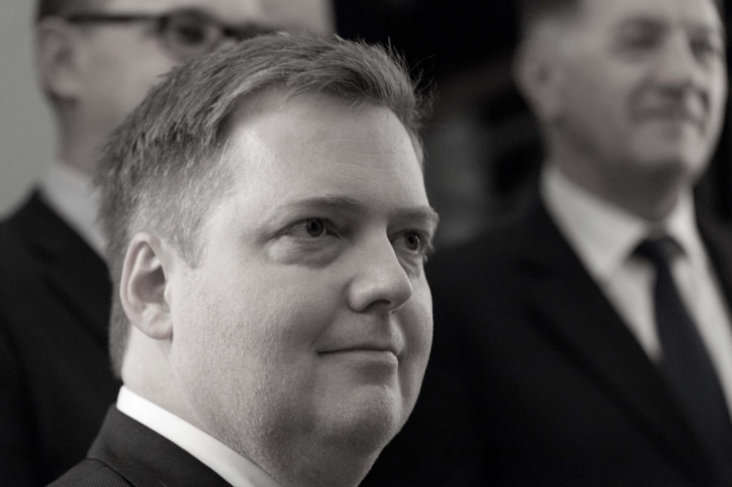
Notes:
Stjórnarráð Íslands
https://www.flickr.com/photos/stjr/
License All rights reserved by
https://www.flickr.com/photos/stjr/22370055709/sizes/k/

Slide 53
International Consortium for Investigative Journalists (ICIJ)
https://source.opennews.org/articles/people-and-tech-behind-panama-papers/
A tool built on past success – 3 years in the making
Apache Solr
Apache Tika
Tesseract
Downfall of World Leaders
Nawaz Sharif – Former Prime Minister of Pakistan
Sigmundur David Gunnlaugsson – Former Prime Minister of Iceland
Extract on GitHub
https://github.com/ICIJ/extract
Notes:
https://www.nytimes.com/2017/07/28/world/asia/panama-papers-pakistan-nawaz-sharif.html?rref=collection%2Ftimestopic%2FPakistan&action=click&contentCollection=world&region=stream&module=stream_unit&version=latest&contentPlacement=1&pgtype=collection
https://source.opennews.org/articles/people-and-tech-behind-panama-papers/
https://github.com/ICIJ/extract

Slide 54
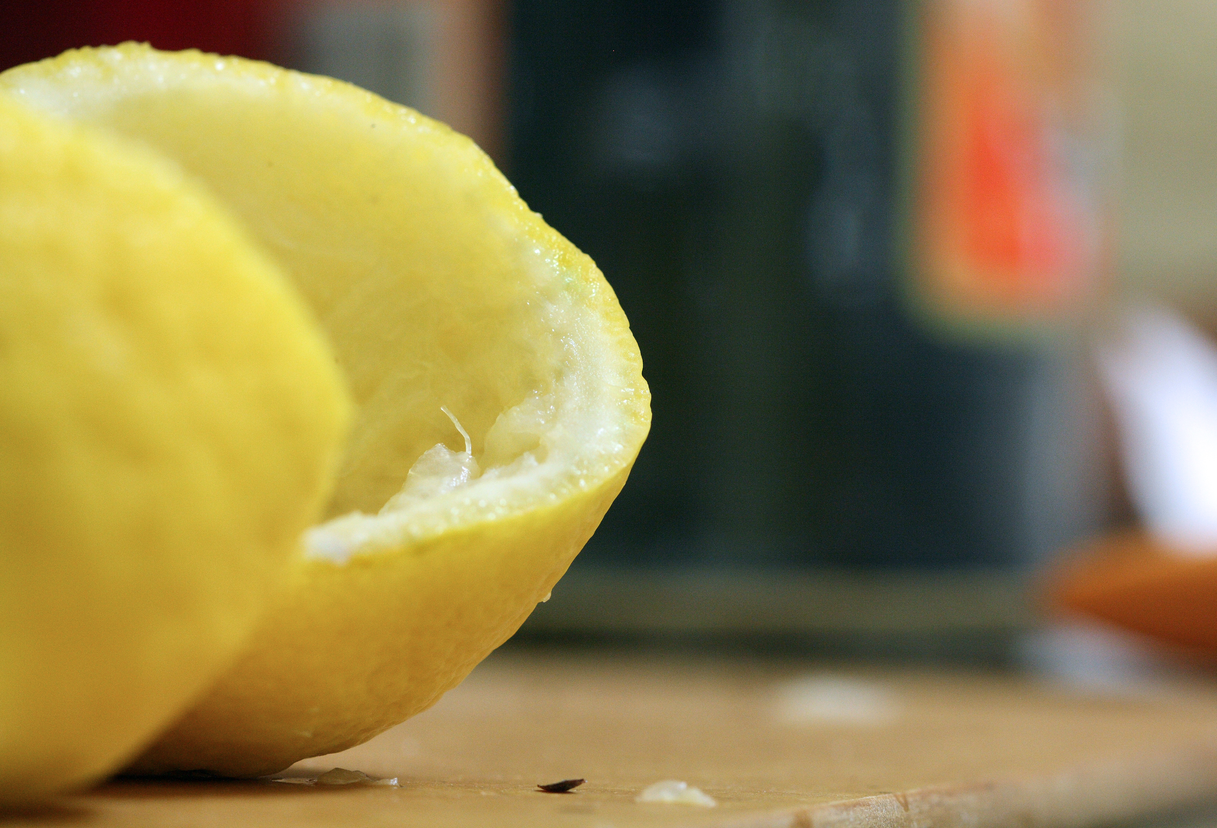
Notes:
Lemon Rind
https://www.flickr.com/photos/8476316@N03/
https://www.flickr.com/photos/8476316@N03/4679070922/sizes/o/

Slide 55
Concluding Remarks
PDF is Data
Make them accessible
This isn’t a library quite yet

Slide 56
Resources
Tika
PDFBox
PDFTabExtract
Jython
Java
Poppler Utils
Tesseract
Notes:
remix.epiccry.com
http://www.openrecords.pa.gov/Appeals/FinalDetRecord.cfm?docket=2011-0467
http://www.achd.net/board/pubs/minutes/050411_boh_minutes.pdf

Slide 57
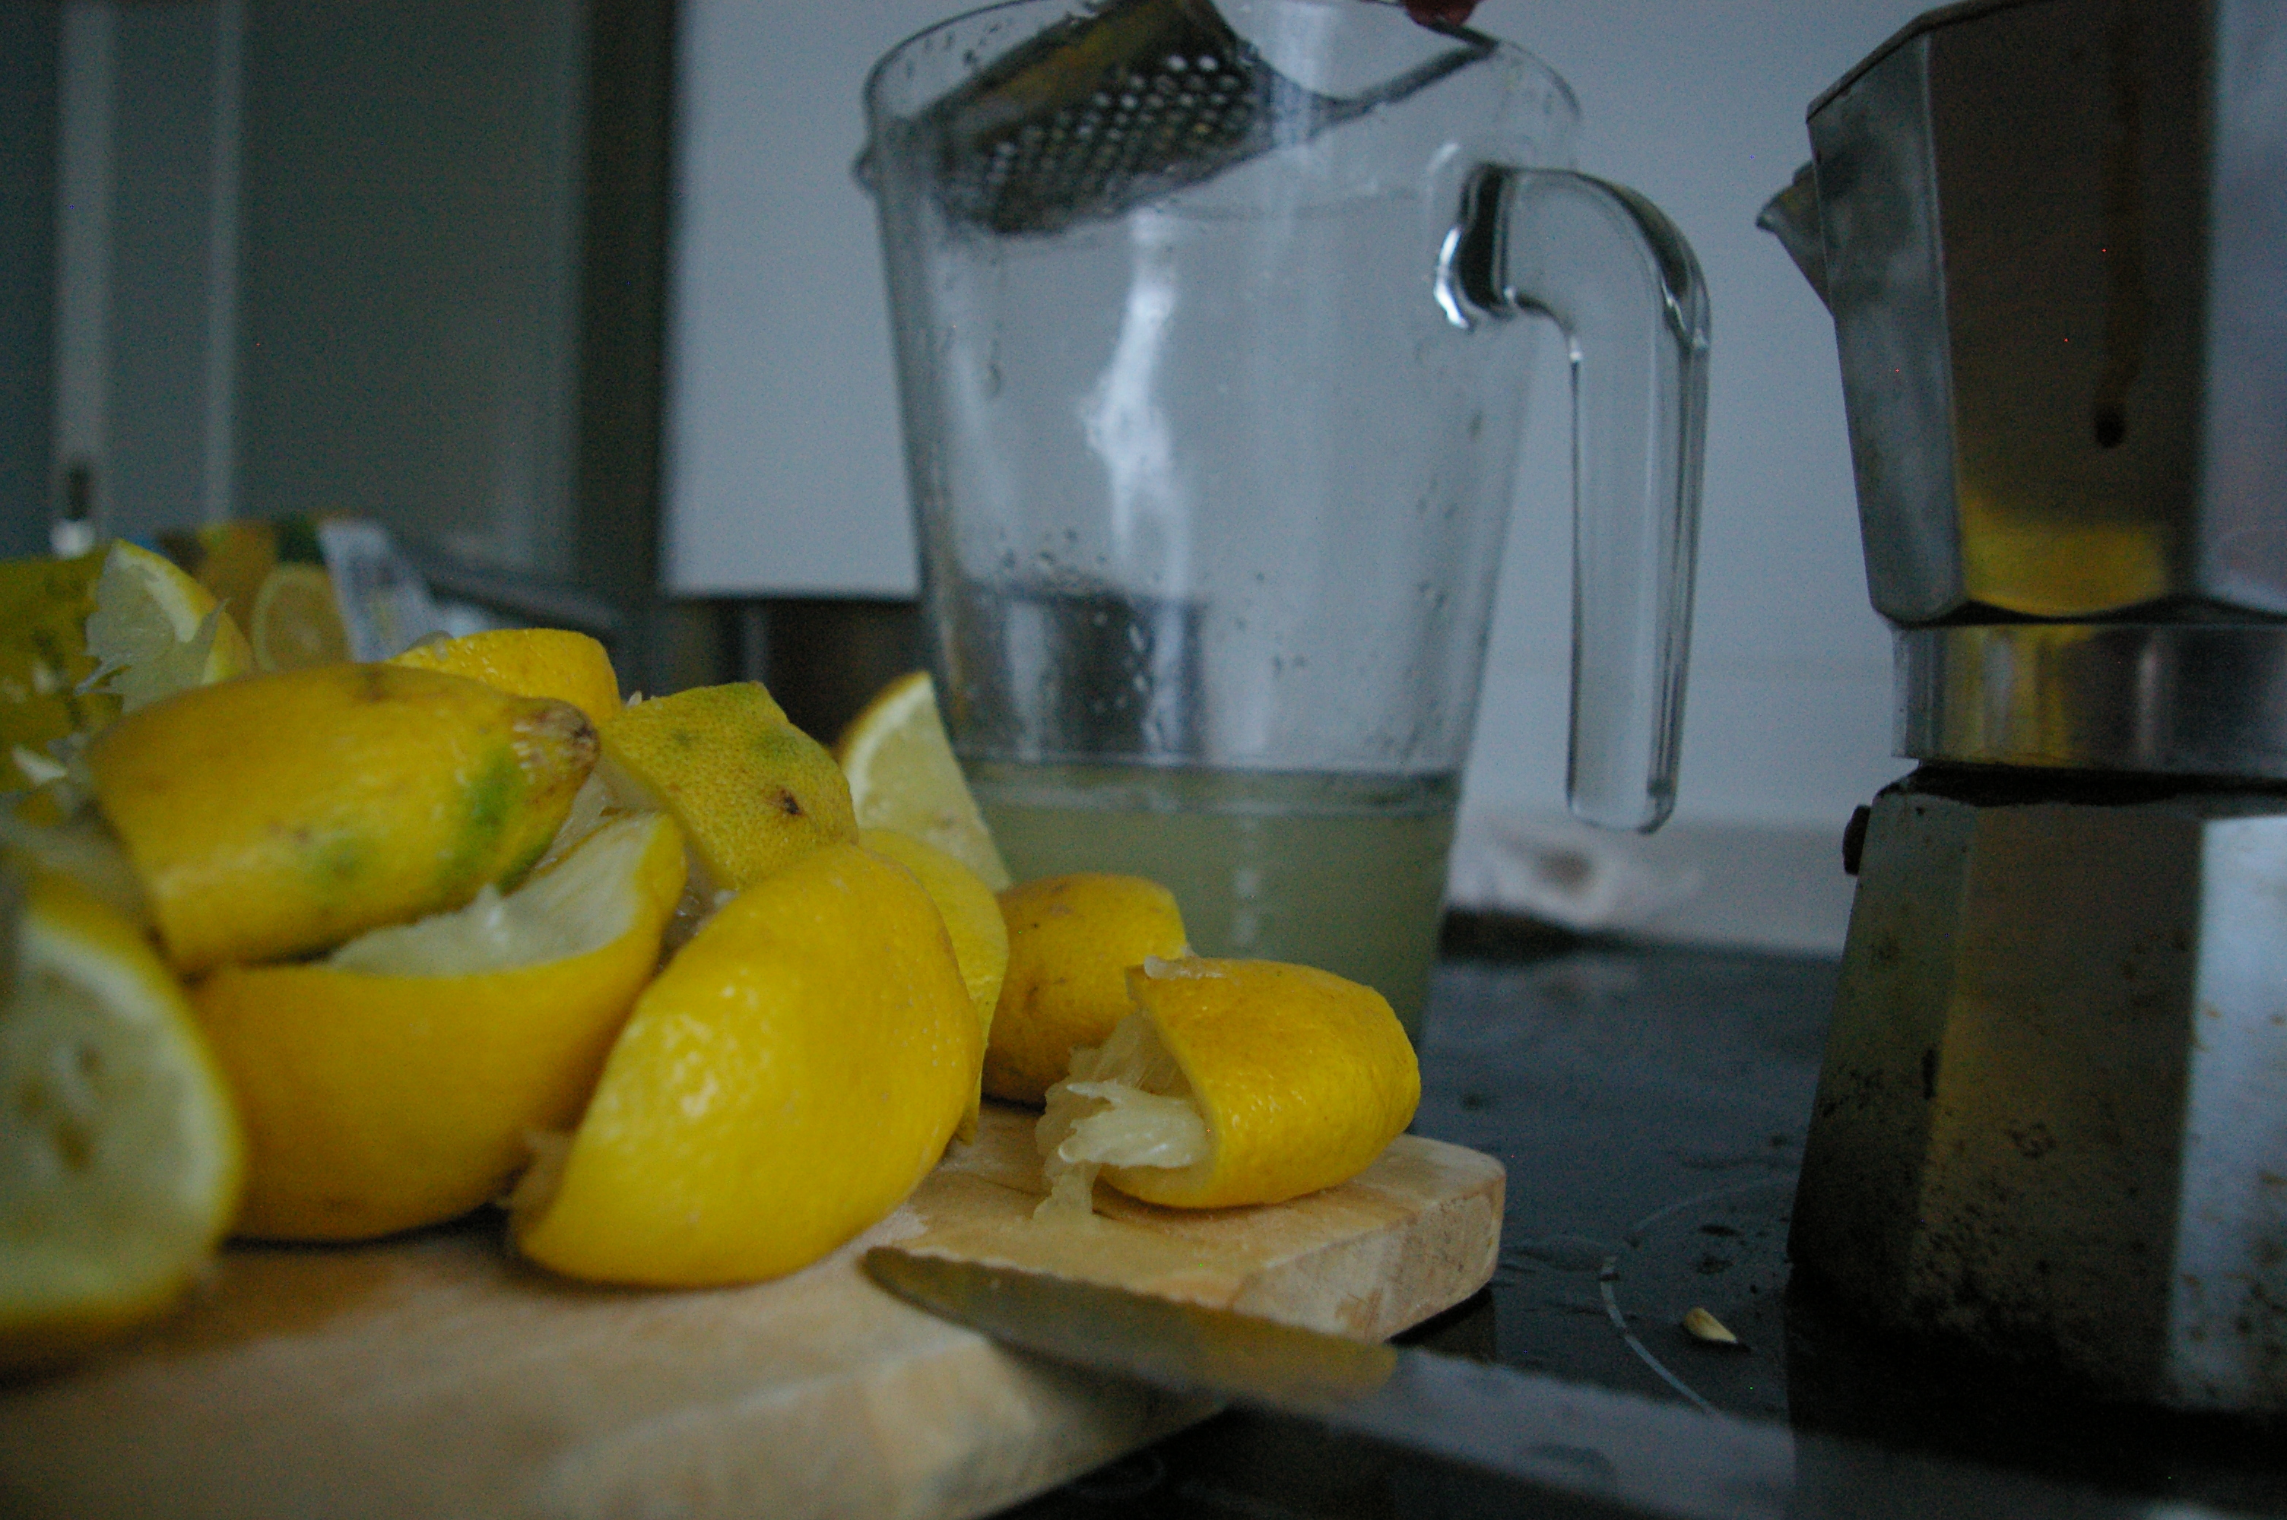
Notes:
Lemon Graveyard
https://www.flickr.com/photos/speculummundi/4823168477/sizes/o/
https://www.flickr.com/photos/speculummundi/

Slide 58
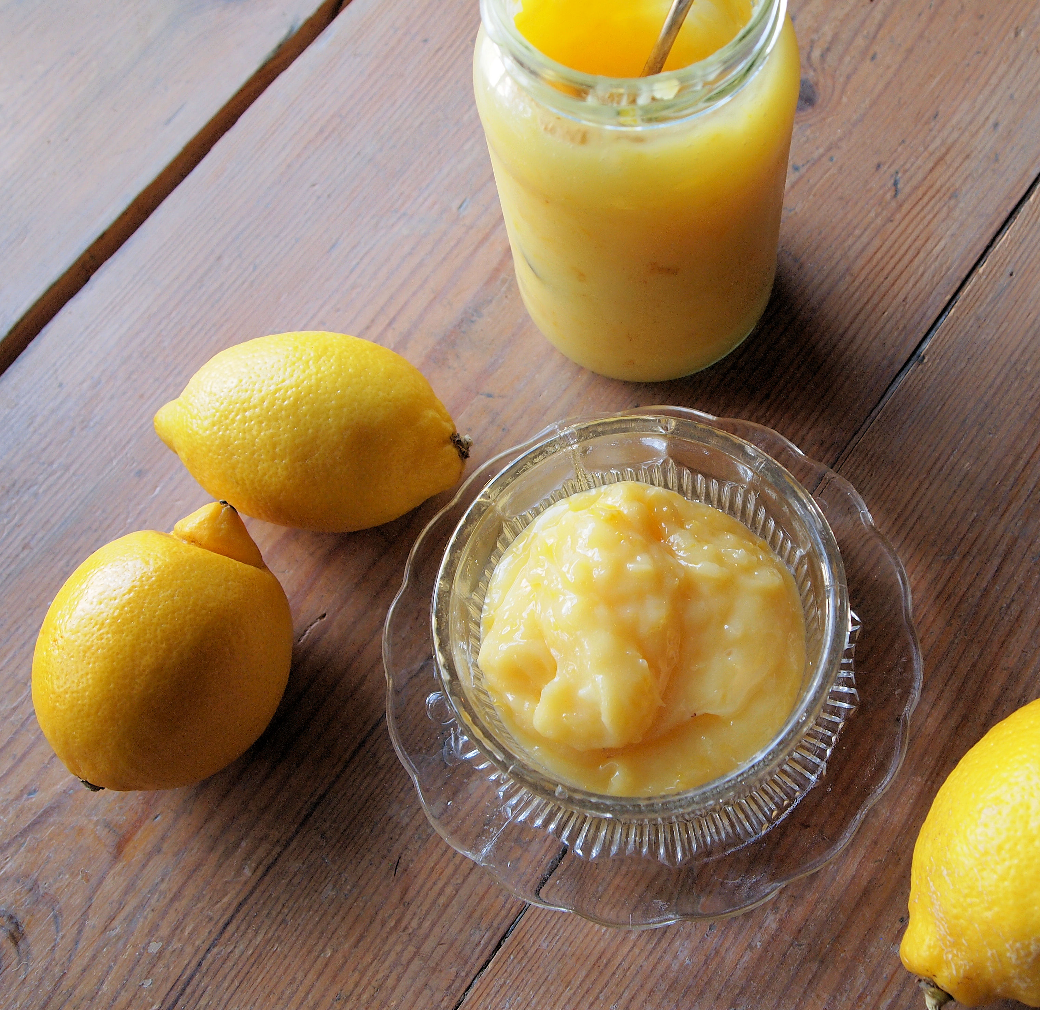
Notes:
Zingy Home-made lemon curd
French Tart
https://www.flickr.com/photos/frenchtart/5483243968/sizes/o/

Slide 59
Notes:
Pidgin lemoncello
https://c1.staticflickr.com/5/4176/33805510234_31b932962b_o_d.jpg
Chris Pople
https://www.flickr.com/photos/60173925@N06/

Slide 60
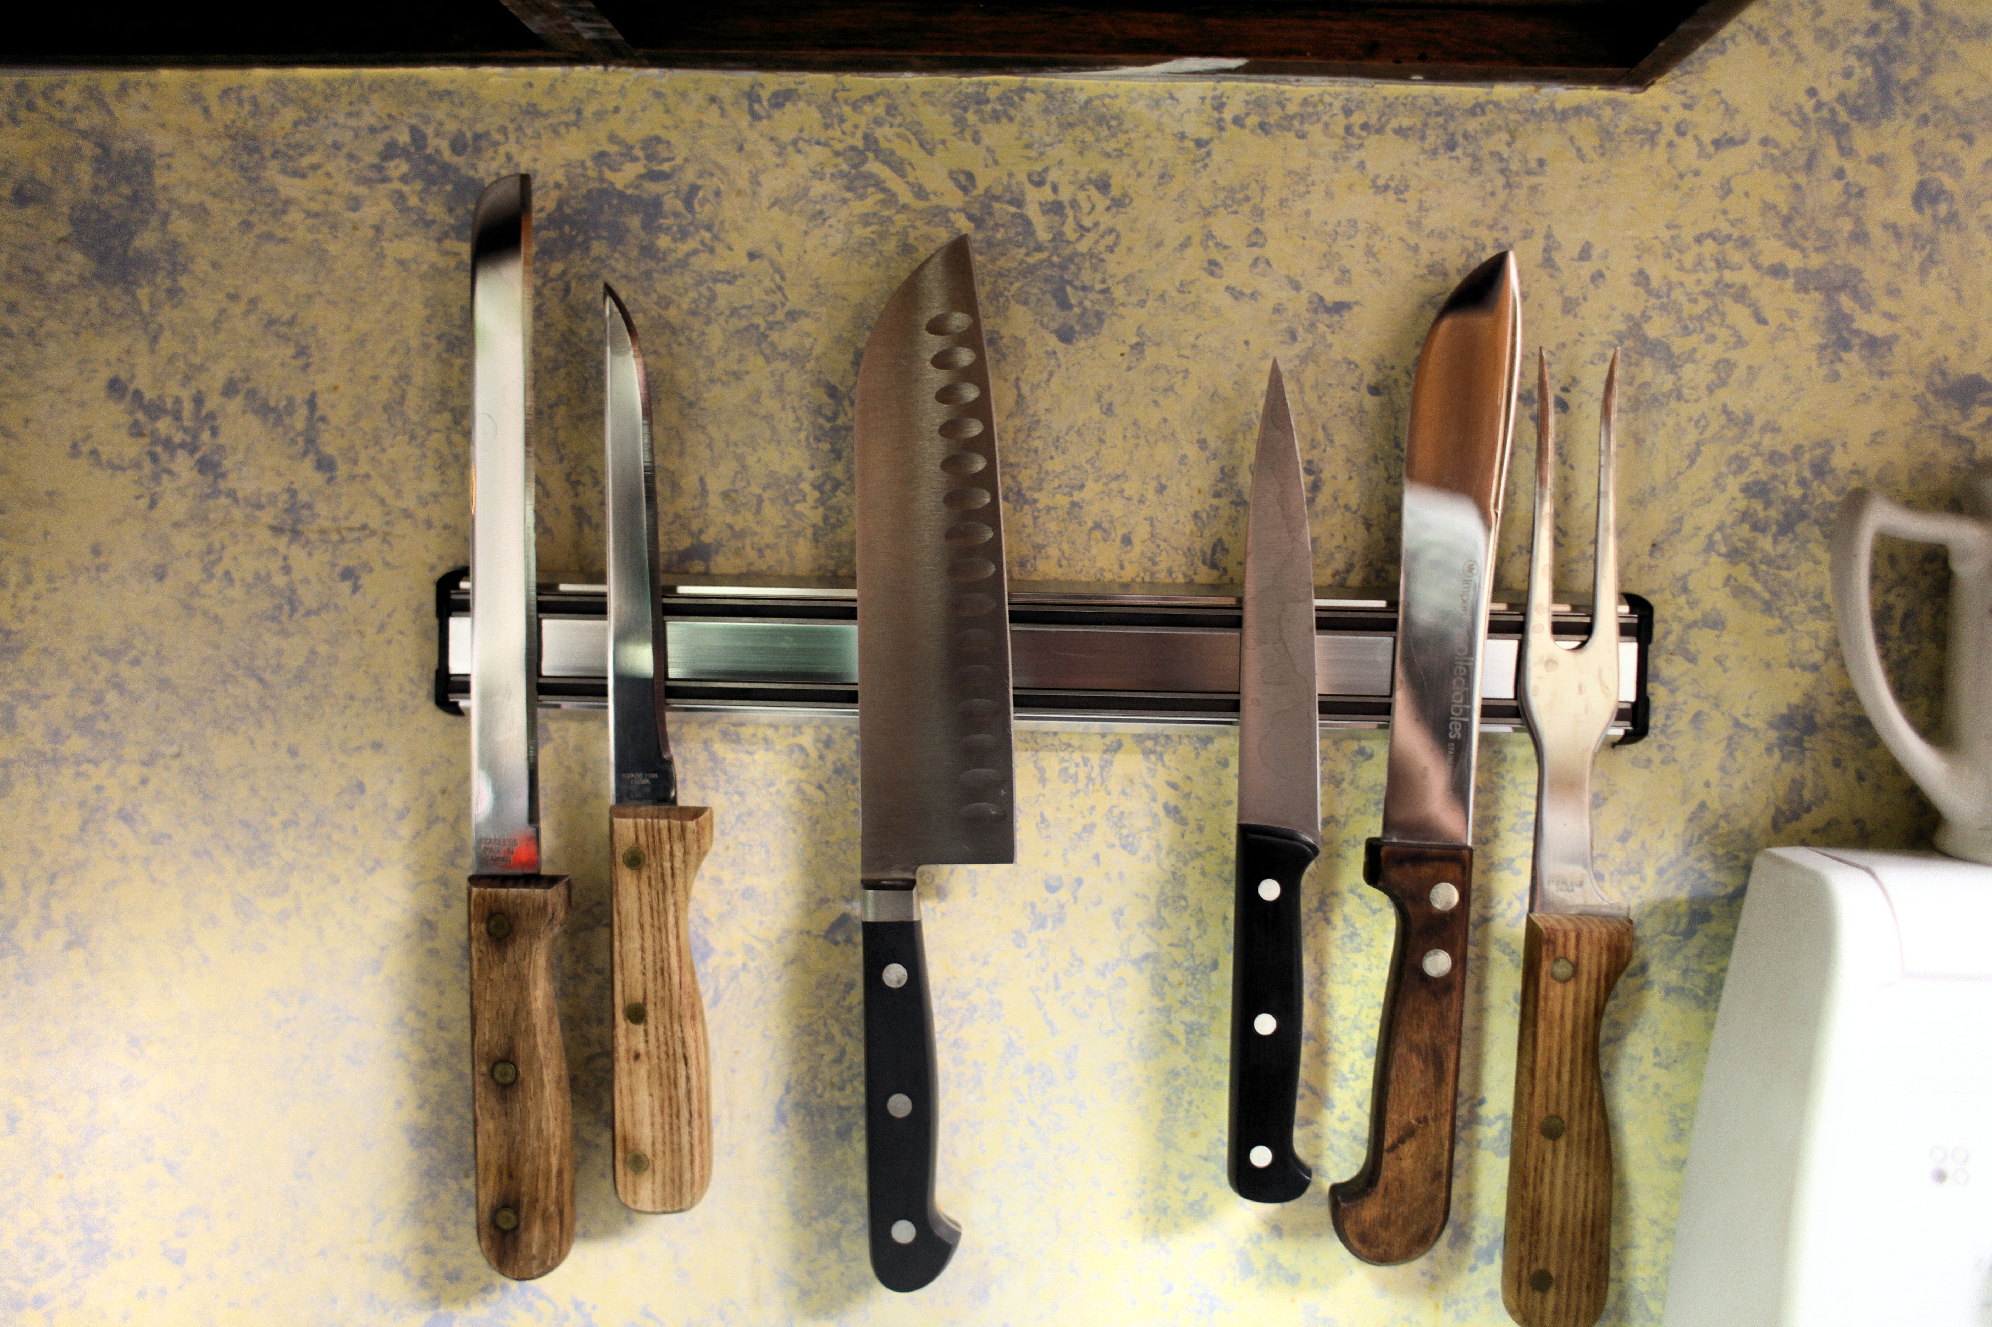

Slide 61
Notes:
Nov 17 - CN - DC - Strawberries 2
USDAgov
https://www.flickr.com/photos/usdagov/15844937015/sizes/o/

Slide 62
Notes:
20111012-FNCS-LSC-0260 by USDepartment of Agriculture
https://www.flickr.com/photos/usdagov/6239460604/sizes/o/
Nov 17 - CN - DC - Strawberries 2 by USDepartment of Agriculture
https://www.flickr.com/photos/usdagov/15844937015/sizes/o/

